Slide 1
Chem
Get HW stamped off
Work on STP Gas Stoichiometry Warm Up Problems
Unit 8 Test Fri 2/22

Slide 2
Non STP Gas Stoichiometry Calculations….
For problems not at STP conditions, you will need to use the ideal gas law with stoichiometry conversions.
If you are given liters in the problem, start with PV=nRT and then do a stoichiometry conversion
If you are looking for liters, start with a stoichiometry conversion and then use PV=nRT

Slide 3
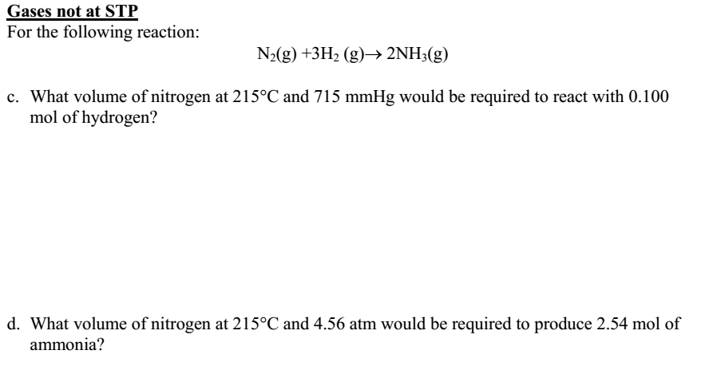
0.100 mol H₂
$$\frac{1 mol N_{2}}{3 mol H_{2}}$$
$$=0.033 mol N2$$
$$plug into PV=nRT$$
715 x V = 0.033 x 62.4 x 488
V = 1.42 L N₂

Slide 4
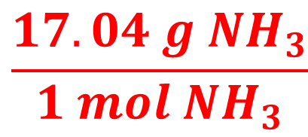
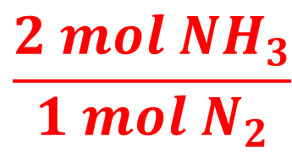
PV = nRT
101 x 5 = n x 8.315 x 488
n= 0.124 mol N₂
$$\frac{2 mol {NH}_{3}}{1 mol N_{2}}$$
$$\frac{17.04 g {NH}_{3}}{1 mol {NH}_{3}}$$
0.124 mol N₂
4.24 g NH₃

Slide 5
Gas Stoich Answers
16.67 g KClO₃
1.26 L CO₂
2.05 L NO
5.24 L H₂
8.68 L gas products
9.21 atm
16.1 L H₂

