Slide 1
Chem
Take out Unit 9 note packet
Get pgs 1 & 2 stamped if you didn’t do so last class
Today:
Notes: Types of Bonds, Polarity
complete up to page 14 (get stamped!)

Slide 2
Vocabulary
Compounds=a substance that has 2 or more different types of elements bonded together
Bond= a region that forms when electrons from different atoms interact with each other. This allows for the formation of a compound
Only valence electrons participate in bonding
Octet Rule
Atoms bond together to get 8 valence electrons around them
Exception: Hydrogen

Slide 3
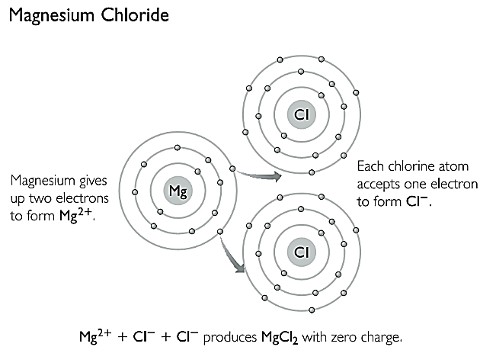
Ionic Bonds
Made up of a METAL and a NONMETAL
Electrons are TRANSFERRED from the metal (cation) to the nonmetal (anion)
Even though the compound is made up of 2 or more charged ions, the compound overall has NO CHARGE (is neutral)
This means that the charge of the CATIONS + charge of ANIONS = 0

Slide 4
Covalent bond
Formed between 2 or more nonmetals
Involves the sharing of valence electrons

Slide 5
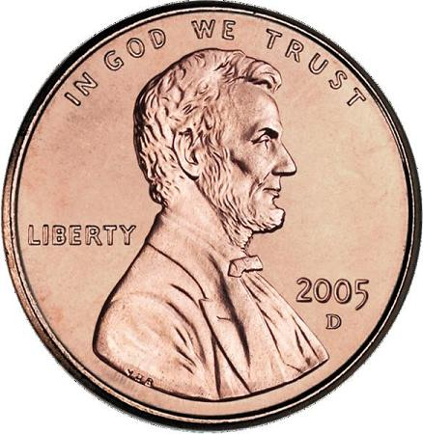
Metallic Bonding: What kind of bonds holds atoms of metals together?
Metals tend to lose their valence electrons to obtain a noble gas electron configuration
In a metallic solid, each atom will try to give their valence electrons to neighboring atoms

Slide 6
Metallic Bonding
There is a constant movement of electrons (aka “sea of mobile electrons”) throughout the entire metallic solid since none of the atoms “wants” the electrons
Cu
Cu
Cu
Cu

Slide 7
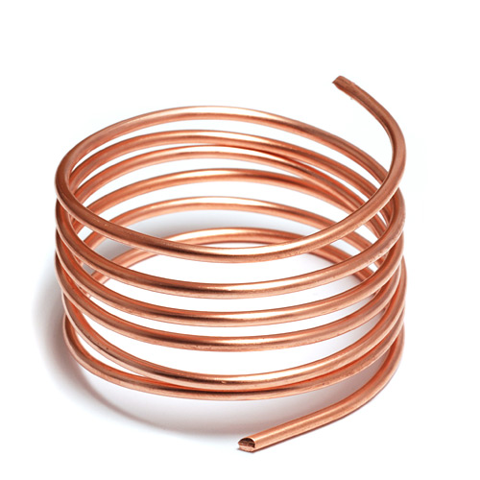
Metallic Bonding
Think of it as a big game of “Hot Potato”
The constant movement of valence electrons is what makes solid metals good conductors of electricity

Slide 8
Summary Chart: Ionic Compounds
Metal + Nonmetal
Electrons are transferred
HIGH melting point & HIGH boiling point
Solids DO NOT conduct electricity
Ionic compounds dissolved in water DO conduct electricity (electrolytes)

Slide 9
Summary Chart: Covalent Compounds
2 or more Nonmetals
Electrons are shared
LOW melting point & LOW boiling point
Solids DO NOT conduct electricity
Covalent compounds dissolved in water DO NOT conduct electricity (nonelectrolytes)

Slide 10
Summary Chart: Metals
Metallic bonds found between metals…
Electrons are constantly moving
HIGH melting point and HIGH boiling point
Solids DO conduct electricity

Slide 11
Add this to bottom of summary chart
Metallic Bonds: Strongest
Ionic bonds: Second Strongest
Covalent Bonds: Weakest

Slide 12
Ionic vs. Covalent
Look at the type of elements bonded together
METAL and a NONMETAL= _________________________
NONMETAL and a NONMETAL= _____________________
Look at the electronegativity difference between the 2 bonded elements
0 - 0.3 ________________________________________
0.4 - 1.7 _______________________________________
> 1.7 ______________________________________
IONIC
COVALENT
NONPOLAR COVALENT
POLAR COVALENT
IONIC

