Slide 1
Chem
Get Phase Diagram WS stamped off from last class
Work on Phase diagram practice
Today: Heating Curve, Heat Energy

Slide 3
Definitions
Kinetic Energy=the energy associated with moving particles (i.e. atoms)
Temperature=measure of the average kinetic energy of a sample of a substance.
Heat=is measured as the energy that is transferred from one object to another because of a difference in temperature. The direction of heat flow is always from the hotter object to the colder object.

Slide 4
Specific Heat Capacity: The amount of energy needed to raise the temperature of 1 gram of a substance by 1°C

Slide 5
Heat Capacity Demo

Slide 6
Answer practice questions
Heat Capacity Questions

Slide 7
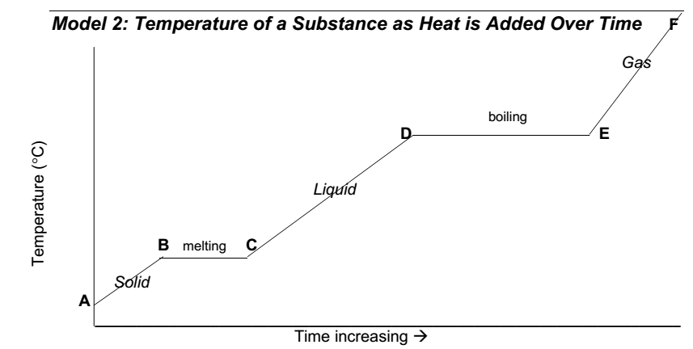
Answer questions 1-6 based on the “Heating Curve”

Slide 8
Kinetic vs. Potential Energy
Kinetic Energy=the energy associated with moving particles; related to temperature.
Potential Energy=the energy associated with the spaces between the atoms It is NOT related to temperature; it is related with phase change

Slide 9
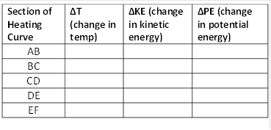
*Heat energy is being transferred to either KE or PE
*When KE is changing, PE remains constant
*When PE is changing, KE remains constant
↑
↑
None
(molecules still pretty close together)
None
(Molecules are getting further apart as solid changes into liquid)
None
↑

Slide 10
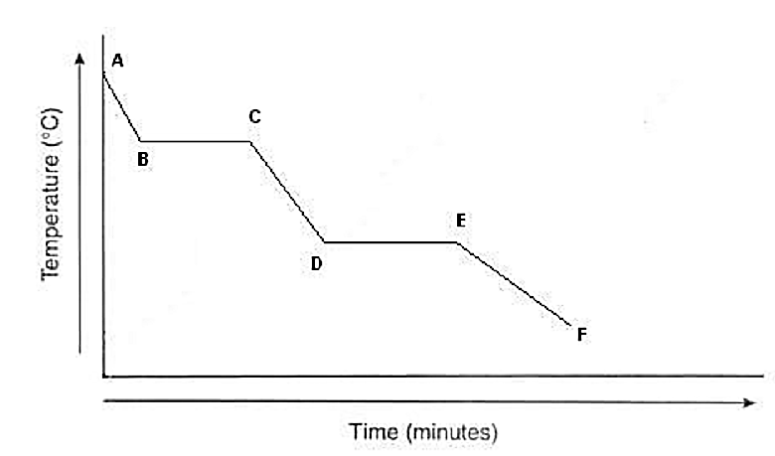
We can also apply the same concepts to a cooling curve, in which a substance is cooled (or heat is removed from a substance) over time.
gas
condensation
liquid
freezing
solid
↓
↓
None
None
None
↓

Slide 11
Heat = Energy transferred due to a difference in temperatures. The amount of heat absorbed or released in a physical or chemical reaction can be calculated using the equation q = mCΔT

Slide 12
Example
How much heat is required to raise the temperature of 5 grams of water from 20°C to 100°C? The specific heat of water is 4.18 J/g°C.

Slide 13
Answer practice questions

Slide 14
Why can’t we use this formula when there is a phase change? Consider the problem “how many joules are required to melt 100 grams of ice at 0°C?”
If we actually tried to use q=mCΔT to solve this problem…
q = 100 g x 4.18 J/g°C x 0°C
q = 0 Joules….
But we know that you need heat energy to melt something…!

Slide 15
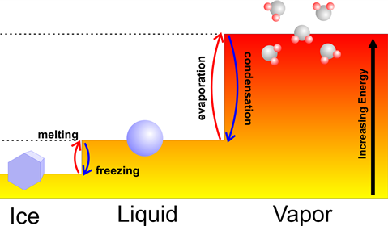
Heat of Fusion: amount of heat energy required to change a substance from a solid to a liquid; Heat energy required to melt a substance: q=mH_{f}
Note: The amount of energy released when a substance changes from liquid to solid is equal to the Heat of Fusion
q=mH_{f}
q=-mH_{f}

Slide 16
Heat of Vaporization: amount of heat energy required to change a substance from a liquid to a gas; heat energy required to boil a substance: q=mH_{v}
Note: the amount of energy released when a substance changes from a gas to a liquid is equal to the Heat of Vaporization
q=mH_{v}
q=-mH_{v}

Slide 17
q=mH_{f} and q=mH_{v} Problems:
1. How many joules are required to melt 100 grams of ice at 0°C? The heat of fusion for water is 334 J/g
q=
m=
H_{f} =
q = 100 g x 334 J/g
100 g
q = 33,400 J
334 J/g

Slide 18
How many joules are absorbed by a 50 gram sample of H₂O that is boiling? The heat of vaporization of water is 2260 J/g
q=
m=
H_{v} =
50 g
q = 50 g x 2260 J/g
2260 J/g
q = 113,000 J

