Slide 1
AP Chem
Take out HW to be checked
Today: Acid-Base Titrations
Unit 6 Test (Acids and Bases) next Thurs 3/15

Slide 2
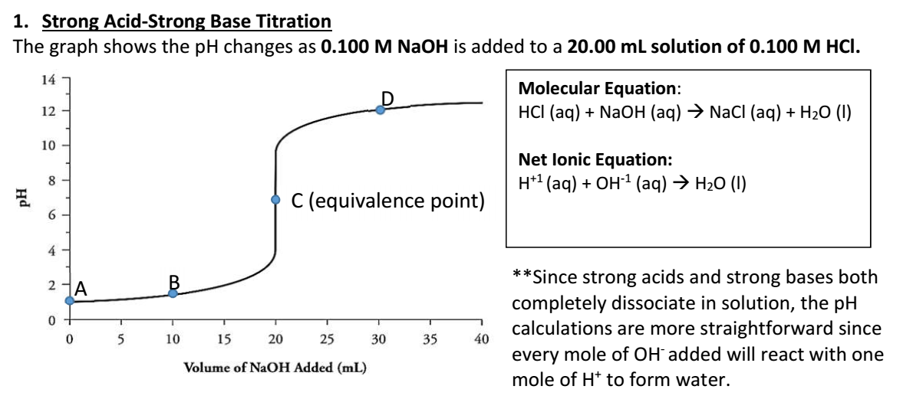

Slide 3
A: At point A, none of the base has been added yet. Calculate the initial pH of the solution at point A (Hint: HCl is a strong acid).
HCl will completely dissociate into H⁺ and Cl⁻ ions in water, therefore [HCl] = [H⁺]
pH = -log [H⁺]
pH = - log (0.1)
pH = 1

Slide 4
At point B, 10.00 mL of the NaOH has been added. To calculate the pH at point B, you will need to apply the Molarity formula and simple stoichiometry.
i. Calculate the number of moles of HCl that is initially in the beaker
(0.1 M)(0.02 L) = 0.002 mol HCl
ii. Calculate the number of moles of NaOH that was added
(0.1 M)(0.01 L) = 0.001 mol NaOH
iii. Calculate the number of moles of HCl that is still unreacted after the addition of NaOH
HCl and NaOH will react in a 1:1 ratio
0.002 mol HCl – 0.001 mol NaOH = 0.001 mol HCl unreacted

Slide 5
At point B, 10.00 mL of the NaOH has been added. To calculate the pH at point B, you will need to apply the Molarity formula and simple stoichiometry.
iv. Determine the new volume of the solution after the addition of the NaOH.
20 mL acid + 10 mL NaOH = 30 mL solution
v. Determine the new Molarity of HCl
$\frac{0.001 mol HCl}{0.03 L}$= 0.033 M HCl
vi. Calculate the pH of the solution at point B.
pH = - log (0.033)
pH = 1.48

Slide 6
At point C, a total of 20.00mL of NaOH has been added to the solution. To calculate the pH at point C, you will need to apply the Molarity formula and simple stoichiometry again
i. Determine the number of moles of HCl that is initially in the beaker (use answer from part B, i)
0.002 mol HCl
ii. Calculate the number of moles of NaOH that was added
(0.1 M)(0.02 L) = 0.002 mol NaOH
iii. Look at your answers for parts i and ii above. What do you know about the acidity/basicity of a solution if the above conditions are true?
Moles of acid = moles of base
Solution is neutral

Slide 7
At point C, a total of 20.00mL of NaOH has been added to the solution. To calculate the pH at point C, you will need to apply the Molarity formula and simple stoichiometry again
iv. Determine the pH of the solution at point C.
pH = 7
v. Notice that point C is labeled as the equivalence point. Explain in terms of amount of HCl and NaOH why this is the equivalence point.
Equal numbers of moles of acid and base present in solution

Slide 8
At point D, a total of 30 mL of NaOH has been added. To calculate the pH at point D, you will need to apply the Molarity formula and simple stoichiometry again.
i. Determine the number of moles of HCl that is initially in the beaker (use answer from part B, i)
0.002 mol HCl
ii. Calculate the number of moles of NaOH that was added
(0.1 M)(0.03 L) = 0.003 mol NaOH
iii. Calculate the number of moles of NaOH that is still unreacted after the addition of NaOH
0.003 mol NaOH – 0.002 mol HCl = 0.001 mol NaOH unreacted

Slide 9
At point D, a total of 30 mL of NaOH has been added. To calculate the pH at point D, you will need to apply the Molarity formula and simple stoichiometry again.
iv. Determine the new volume of the solution after the addition of the NaOH.
20 mL acid + 30 mL NaOH = 50 mL solution
v. Use your answers from parts iii and iv above to determine the new Molarity of NaOH
$\frac{0.001 mol NaOH}{0.05 L}$= 0.02 M NaOH
vi. Now, calculate the pH of the solution at point D (Hint: calculate pOH first).
pOH = - log (.02) = 1.70
pH = 12.30

Slide 10
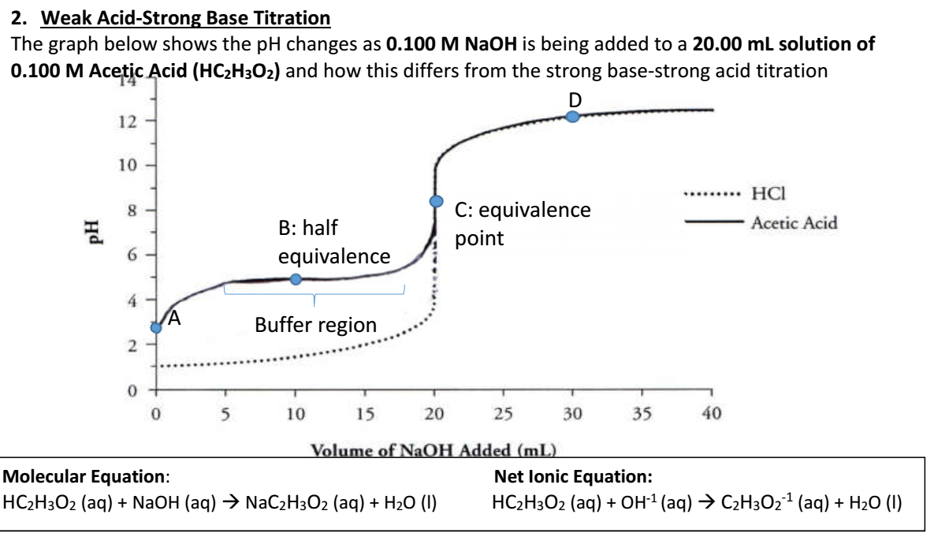

Slide 11
***Since weak acids do not completely dissociate in solution, pH calculations are a little more complicated…
Visually speaking, what are some key differences between a strong acid-strong base titration curve and a weak acid-strong base titration curve?

Slide 12
At point A, none of the base has been added yet. Calculate the initial pH of the solution at point A (Hint: Acetic Acid is a weak acid, so set up an equilibrium calculation using Ka). Ka for acetic acid = 1.8 x 10⁻⁵
HC₂H₃O₂ ⇆ H⁺ + C₂H₃O₂⁻
0.1 M
0
0
Ka = $\frac{X^{2}}{0.1−X}$ = 1.8 x 10⁻⁵
-x
+x
+x
0.1-x
x
x
x = [H+]= 0.00134 M
pH = - log (0.00134)
pH = 2.87

Slide 13
When 5 mL of the NaOH has been added:
i. Calculate the number of moles of HC₂H₃O₂ that is initially in the beaker
(0.1 M) x (0.02 L) = 0.002 mol acid
ii. Calculate the number of moles of NaOH that was added. This value will be the same as the number of moles of C₂H₃O₂⁻¹, the conjugate base, that is formed.
(0.1 M) x (0.005 L) = 5 x 10⁻⁴ mol base
iii. Calculate the number of moles of HC₂H₃O₂ that is still unreacted after the addition of NaOH
0.002 mol acid – 5 x 10⁻⁴ mol base = 0.0015 mol acid
iv. Determine the new volume of the solution after the addition of the NaOH.
20 mL acid + 5 mL base = 25 mL solution

Slide 14
v. Use your answers from parts ii-iv above to determine the molarity of undissociated HC₂H₃O₂ (HA) that and the molarity of the conjugate base C₂H₃O₂⁻¹ (A⁻) that has formed.
[HA] =$\frac{0.0015 mol}{0.025 L}$= 0.06 M [A-]=$\frac{5 x {10}^{−4} mol}{0.025 L}=0.02 M$
vi. Plug in values into the Henderson-Hasselbalch equation to solve for pH.
pH = pKa + log $\frac{[A−]}{[HA]}$
pH = - log (1.8 x 10⁻⁵) + log ($\frac{0.02}{0.06})$
pH = 4.27

Slide 15

pH = pKa + log $\frac{[A−]}{[HA]}$
pH = pKa
pH = 4.74

Slide 16
To calculate the pH at the equivalence point:
Determine the number of moles of HC₂H₃O₂ that is initially in the beaker (you can use your answer from the previous problem). This value will be the same as the number of moles of C₂H₃O₂⁻¹, the conjugate base, that is present at the equivalence point.
0.002 mol
Calculate the new volume of the solution after the addition of the NaOH at the equivalence point
20 mL acid + 20 mL base = 40 mL solution
Determine the concentration of C₂H₃O₂⁻¹ at the equivalence point.
$\frac{0.002 mol}{.040 L}=0.05 M$

Slide 17
C₂H₃O₂⁻¹ is a weak base. Set up a Kb expression to calculate the concentration of OH⁻¹ in solution at the equivalence point (you can use an ICE table to help you). Hint: Kw = Ka x Kb
C₂H₃O₂⁻¹ (aq) + H₂O (l) ⇆ HC₂H₃O₂ (aq) + OH⁻ (aq)
0.05 M
0 M
0 M
-x
+x
+x
0.05 - x
x
x
K_{b} = $\frac{X^{2}}{0.05−X}$ = $\frac{Kw}{Ka}$ ⁼ $\frac{1 x {10}^{−14}}{1.8 x {10}^{−5}}$
x = [OH-]= 5.27 x 10⁻⁶ M
pOH = 5.28
pH = 8.72

Slide 18
To calculate the pH when 30 mL of NaOH has been added:
Determine the number of moles of HC₂H₃O₂ that is initially in the beaker (you can use your answer from the previous problem).
0.002 mol HC₂H₃O₂
Calculate the number of moles of NaOH that was added.
(0.1 M) x (0.03 L) = 0.003 mol NaOH
Calculate the number of moles of NaOH that is still unreacted after the addition of NaOH
0.003 mol base – 0.002 mol acid = 0.001 mol base
Determine the Determine the new volume of the solution after the addition of the NaOH.
20 mL acid + 30 mL base = 50 mL solution

Slide 19
Use your answers above to calculate the molarity of OH⁻¹ at point D
$\frac{0.001 mol OH−}{0.05 L}$=0.02 M OH⁻
Calculate the pOH and then pH of the solution.
pOH = 1.70
pH = 12.3

Slide 20
Other Titrations
Strong Base-Strong Acid
Similar to first example, but starting with a high pH
Equivalence point is still pH = 7
Strong Acid-Weak Base
Similar to second example, but starting with a high pH
Equivalence point will be pH < 7
Titration of Polyprotic Acids
Multiple Hydrogen’s can be dissociated
There will be multiple equivalence points for each Ka

