Slide 1
AP Chem
Work on Le Chatelier’s Principle Warm Up (#1)
Get HW checked
Today: Equilibrium Constant

Slide 2
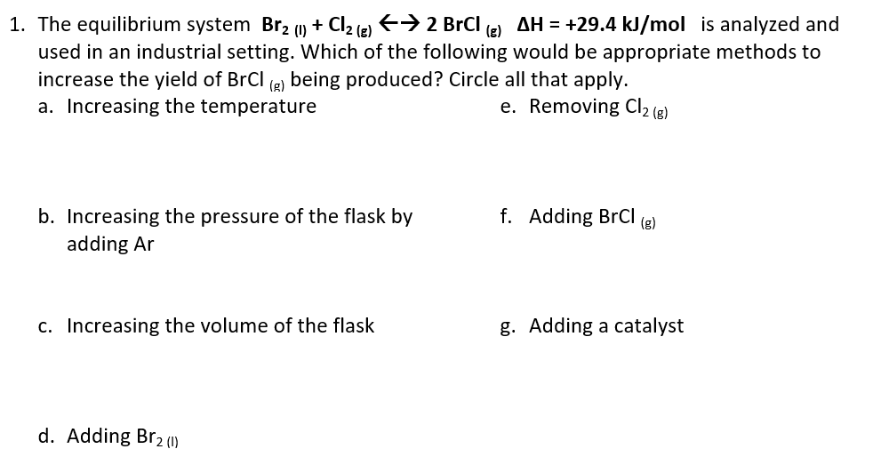

Slide 3
(HCl = H⁺ + Cl⁻ in solution).
H+ reacts with OH-.
Since [OH-] decreases, the equilibrium shifts to the right, so more Ca(OH)₂ will dissociate into ions

Slide 4
(Ca(NO₃)₂= Ca²⁺ + 2 NO₃⁻ ions in solution)
Since more Ca²⁺ is added, the equilibrium shifts to the left, so more Ca(OH)₂ (s) will precipitate.

Slide 5
Heat was removed and the equilibrium shifted to the left (more Ca(OH)₂ was produced).
The reaction must be endothermic.

Slide 6
Deriving the Equilibrium Constant
Consider the following system at equilibrium:
Forward reaction: N₂O_{4 (g)} ⎯⎯→ 2 NO_{2 (g)}
Rate Law: Rate = k_{f} [N₂O₄]
N₂O_{4 (g)}
2 NO_{2 (g)}

Slide 7
Deriving the Equilibrium Constant
N₂O_{4 (g)}
2 NO_{2 (g)}
Reverse reaction: 2 NO_{2 (g)} ⎯⎯→ N₂O_{4 (g)}
Rate Law: Rate = k_{r} [NO₂]²

Slide 8
Deriving the Equilibrium Constant
At equilibrium,
Rate_{forward} = Rate_{reverse}
k_{f} [N₂O₄] = k_{r} [NO₂]²
Rewriting this, it becomes
k_{f}
k_{r}
[NO₂]²
[N₂O₄]
=

Slide 9
The Equilibrium Constant
The ratio of the rate constants is a constant at that temperature, and the expression becomes
k_{f}
k_{r}
[NO₂]²
[N₂O₄]
K_{eq} =
=

Slide 10
The Equilibrium Constant
Consider the generalized reaction
aA + bB
cC + dD
The equilibrium expression for this reaction would be
Equilibrium constant expression
[C]^{c}[D]^{d}
[A]ª[B]^{b}
K_{eq} =
** the equilibrium constant expression depends only on the stoichiometry and temperature, NOT on its mechanism!!

Slide 11
Some notes about K…
It does not have units
Only gases and aqueous substances are included as part of the equilibrium expression. Solids and liquids are omitted from equilibrium expressions.
There are different types of K constants depending on the reaction

Slide 12
Types of K (Equilibrium Constants)
K_{c} – Equilibrium Constant Using Concentration (Molarity)
K_{p} – Equilibrium Constant Using Gas Partial Pressures
K_{sp} – Solubility Product Constant (used for partially soluble solids)
**Remember, only gases and aqueous substances are included as part of the K equilibrium expression!

Slide 13
Meaning of K
If K < 1, the reaction favors the reactants (more reactants present at equilibrium)
If K > 1, the reaction favors the products (more products present at equilibrium)

Slide 14
Practice:
Write the equilibrium expression for K_{c} for the following reactions:
2 O₃ (g) ⇌ 3 O₂(g)
2 NO (g) + Cl₂ (g) ⇌ 2 NOCl (g)
Ag⁺(aq) + 2 NH₃ (aq) ⇌ Ag(NH₃)₂⁺(aq)
2 Ag (s) + Zn²⁺ (aq) ⇌ 2 Ag⁺ (aq) + Zn (s)

