Slide 1
AP Chem
Take out packet to get stamped off
Today: Reaction rate and order

Slide 2
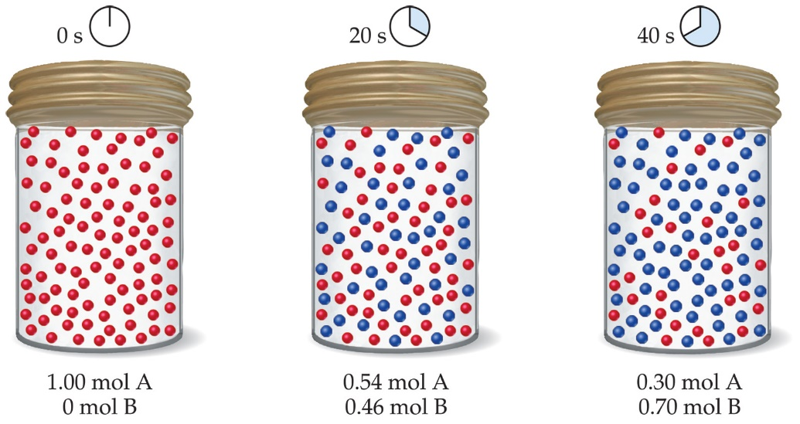
Reaction Rates
Rates of reactions can be determined by monitoring the change in concentration of either reactants or products as a function of time.

Slide 4
Reaction Rates
Average Rate = Δ[X]
Δ t
[X] = concentration of reactant disappearing OR product forming
t = time
Rate A = [ 0.73M – 1.00M]
10s – 0s
Rate A = 0.027M/s
Always a positive value

Slide 5
0 s to 10 s = 0.027 M/s
10 s to 20 s = 0.019 M/s
20 s to 30 s = 0.014 M/s
30 s to 40 s = 0.010 M/s
40 s to 50 s = 0.009 M/s
50 s to 60 s = 0.005 M/s

Slide 6
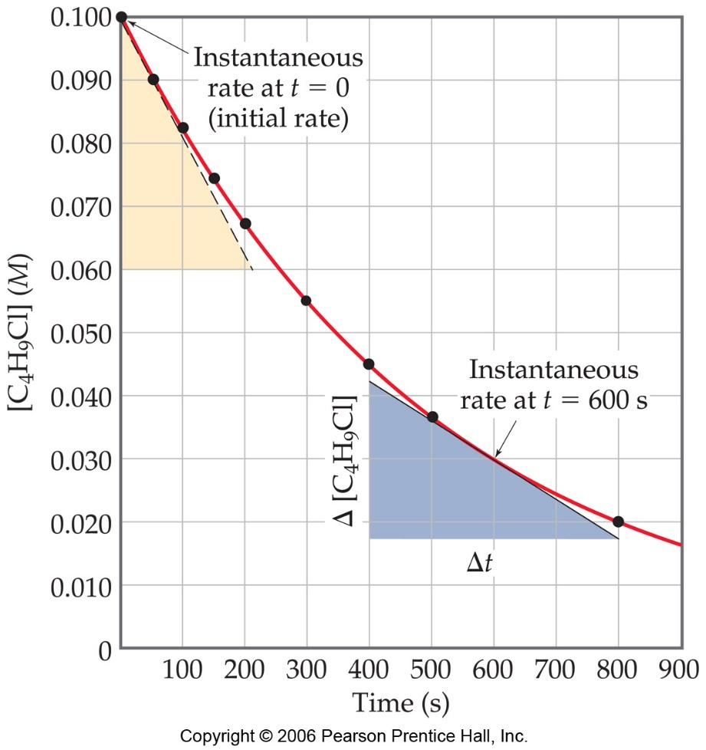
Reaction Rates
C₄H₉Cl(aq) + H₂O(l) ⎯⎯→ C₄H₉OH(aq) + HCl(aq)
Note that the average rate decreases as the reaction proceeds.
This is because as the reaction goes forward, there are fewer collisions between reactant molecules.

Slide 7
Reaction Rates
C₄H₉Cl(aq) + H₂O(l) ⎯⎯→ C₄H₉OH(aq) + HCl(aq)
A plot of [C₄H₉Cl] vs. time for this reaction yields a curve like this.
The slope of a line tangent to the curve at any point is the instantaneous rate at that time.

Slide 8
Reaction Rates
C₄H₉Cl(aq) + H₂O(l) ⎯⎯→ C₄H₉OH(aq) + HCl(aq)
The instantaneous rate at t = 0 is called the initial rate of the reaction.
All reactions slow down over time. Therefore, the best indicator of the rate of a reaction is the instantaneous rate near the beginning of the reaction.

Slide 9
Reaction Rates and Stoichiometry
C₄H₉Cl(aq) + H₂O(l) ⎯⎯→ C₄H₉OH(aq) + HCl(aq)
In this reaction, the ratio of C₄H₉Cl to C₄H₉OH is 1:1.
Thus, the rate of disappearance of C₄H₉Cl is the same as the rate of appearance of C₄H₉OH.
-Δ[C₄H₉Cl]
Δt
Δ[C₄H₉OH]
Δt
Rate =
=

Slide 10
Reaction Rates and Stoichiometry
What if the ratio is not 1:1?
2 HI(g) ⎯⎯→ H₂(g) + I₂(g)
In such a case,
1
2
Δ[HI]
Δt
Δ[I₂]
Δt
Rate = −
=

Slide 11
Reaction Rates and Stoichiometry
To generalize, then, for the reaction
aA + bB
cC + dD
1
a
Δ[A]
Δt
1
b
Δ[B]
Δt
1
c
Δ[C]
Δt
1
d
Δ[D]
Δt
Rate = −
= −
=
=

Slide 12
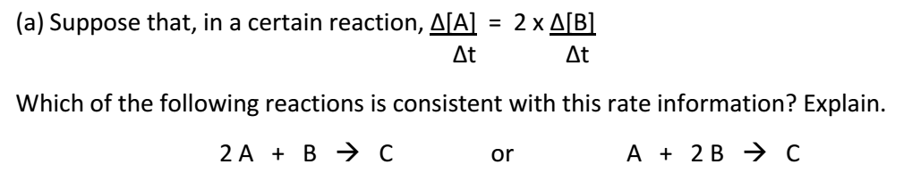
The relationship shows that the change in A over time is twice as much as the change in B over time.
So you want the reaction that shows that 2 moles of A are consumed for every 1 mole of B that is consumed.

Slide 13
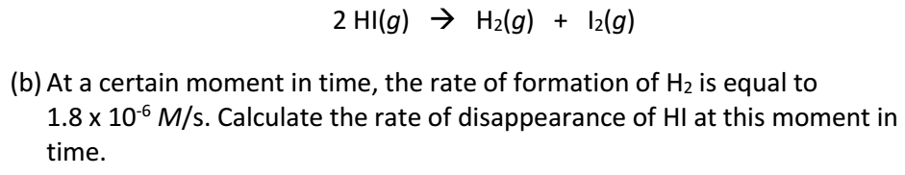
The rate of disappearance of HI is twice as much as the rate for formation of H₂
(1.8 x 10⁻⁶ M/s) x 2 = 3.6 x 10⁻⁶ M/s

Slide 14
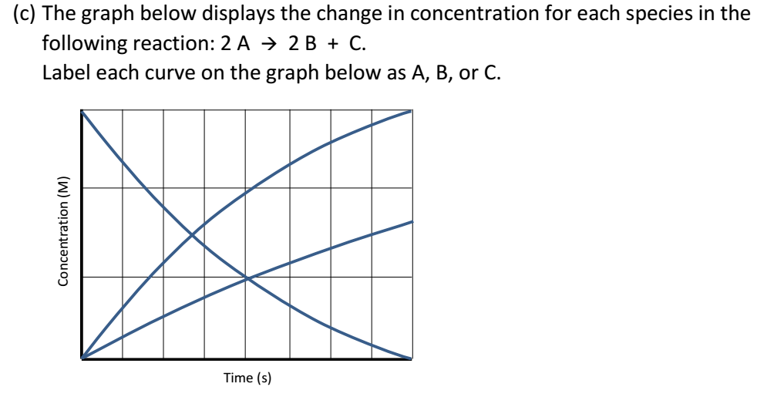

Slide 15
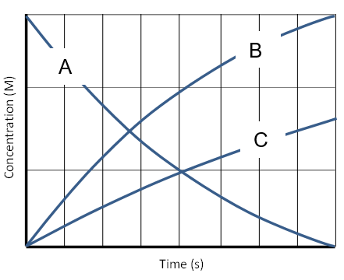

Slide 16
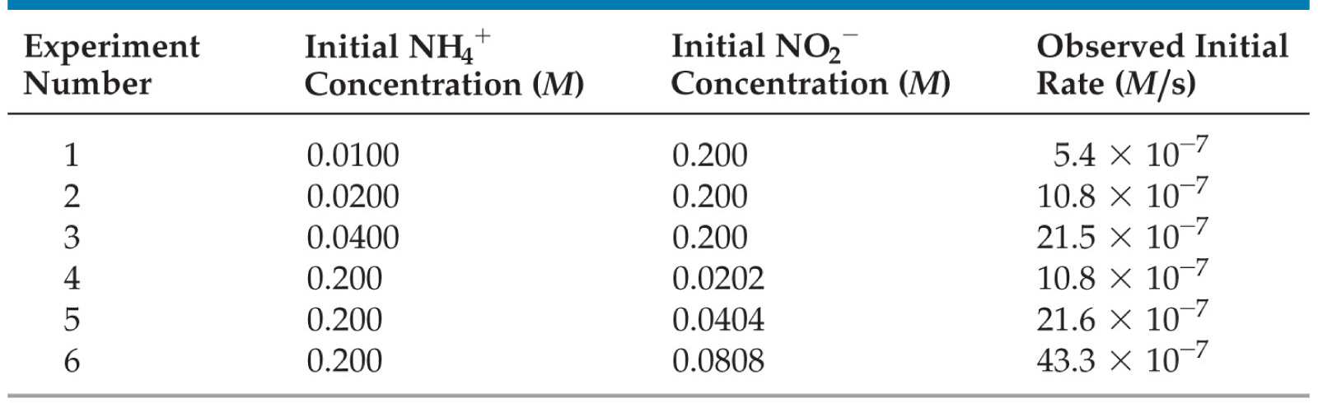
Concentration and Rate
One can gain information about the rate of a reaction by seeing how the rate changes with changes in concentration.

Slide 17
Concentration and Rate
NH₄⁺(aq) + NO₂⁻(aq)
N₂(g) + 2 H₂O(l)
If we compare Experiments 1 and 2, we see that when [NH₄⁺] doubles, the initial rate doubles.

Slide 18
Concentration and Rate
NH₄⁺(aq) + NO₂⁻(aq)
N₂(g) + 2 H₂O(l)
Likewise, when we compare Experiments 5 and 6, we see that when [NO₂⁻] doubles, the initial rate doubles.

Slide 19
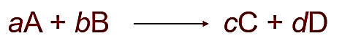
Rate Law
Rate law = an equation which shows how the rate depends on the concentration of reactants. For a general reaction,
the rate law generally has the form
Rate = k[A]^{m}[B]^{n}
k = rate constant; temperature dependent
m and n = typically small whole numbers; tell you about the reaction order

Slide 20
Concentration and Rate
Based on the experimental data,
Rate ∝ [NH₄⁺]
Rate ∝ [NO₂⁻]
Rate ∝ [NH₄⁺] [NO₂⁻]
which, when written as an equation, becomes
Rate = k [NH₄⁺] [NO₂⁻]
This equation is called the rate law, and k is the rate constant.
Therefore,

Slide 21
rate = k [NH₄⁺] [NO₂–]
Using the data from experiment 1,
5.4 x 10⁻⁷ M/s = (k)(0.0100 M)(0.200 M)
k = 2.7 x 10⁻⁴ M⁻¹ s⁻¹
(units for k have to cancel out with M² so that you’re left with M/sec, the unit for rate)

Slide 22
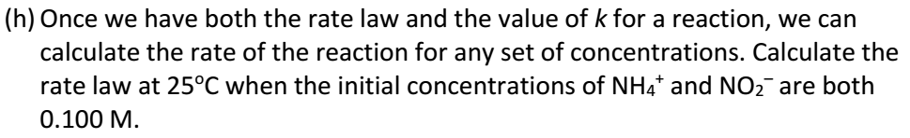
rate = k [NH₄⁺] [NO₂–]
rate = (2.7 x 10⁻⁴ M⁻¹ s⁻¹)(0.100 M)(0.100 M)
rate = 2.7 x 10⁻⁶ M/s

Slide 23
Rate Laws
A rate law shows the relationship between the reaction rate and the concentrations of reactants.
The exponents tell the order of the reaction with respect to each reactant.
Since the rate law is
Rate = k [NH₄⁺] [NO₂⁻]
the reaction is
First-order in [NH₄⁺] and
First-order in [NO₂⁻].

Slide 24
Rate Laws
Rate = k [NH₄⁺] [NO₂⁻]
The overall reaction order can be found by adding the exponents on the reactants in the rate law.
This reaction is second-order overall.

Slide 25
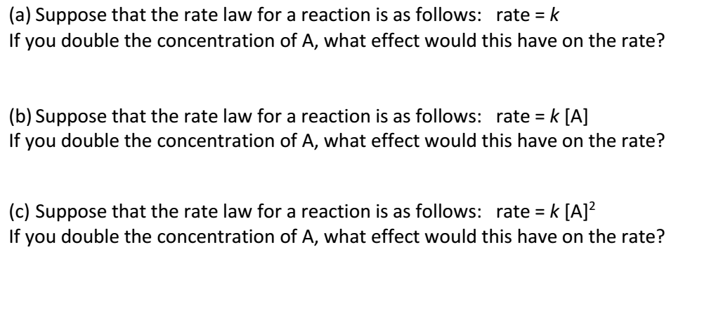
No effect
Rate would double
Rate would quadruple

Slide 26
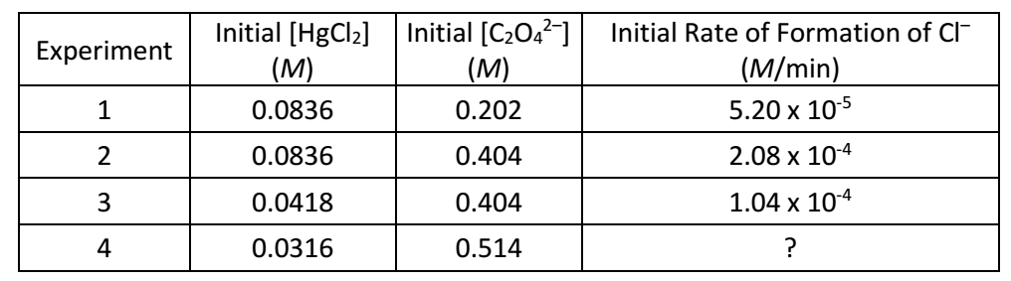
Compare experiments 2 and 3
When [HgCl₂] is doubled and [C₂O₄²⁻] is held constant, the reaction rate is doubled.
Therefore, the reaction is 1st order with respect to [HgCl₂]

Slide 27
Compare experiments 1 and 2
When [C₂O₄²⁻] is doubled and [HgCl₂] is held constant, the reaction rate is quadrupled
Therefore, the reaction is 2nd order with respect to [C₂O₄²⁻]

Slide 28
Rate = k [HgCl₂] [C₂O₄²⁻]² , 3rd order overall
(Plug in data from any experiment to solve for k)
(5.20x10⁻⁵ M/min) = k [0.0836 M][0.202 M]²
k = 0.0152 M⁻² min ⁻¹
(units for k have to cancel out with M³ so that you’re left with M/min, the unit for rate)

Slide 29
2 moles of Cl⁻ are formed for every 1 mole of C₂O₄²⁻ that is consumed…
Initial rate of disappearance of C₂O₄²⁻ for exp 1 = (5.20 x 10⁻⁵ M/min) / 2 = 2.6 x 10⁻⁵ M/min

Slide 30
Exp 4: Rate = k[HgCl₂][C₂O₄²⁻]², k=0.0152 M⁻² min ⁻¹
Rate = (0.0152 M⁻² min ⁻¹)[.0316 M][.514 M]²
Rate = 1.27 x 10⁻⁴ M/min

