Slide 1
Directions
Use this powerpoint to fill in notes on properties of gases
Complete the practice problems in your notes.

Slide 2
Kinetic Molecular Theory
States that particles of matter are always in constant, rapid motion
Explains properties of gases, liquids, and solids in terms of energy using an ideal gas
Ideal Gas-
an imaginary gas which fits all the assumptions of kinetic molecular theory

Slide 3
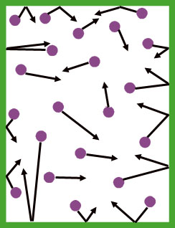
Kinetic Molecular Theory
Assumptions:
Gases are mostly empty space (tiny, spread out particles)

Slide 4
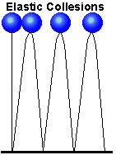
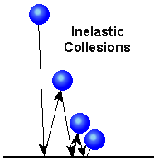
Kinetic Molecular Theory
Assumptions:
Elastic collisions occur between gas particles
No loss of kinetic energy
Kinetic Energy-
energy of movement (speed)
Potential Energy-
stored energy

Slide 5
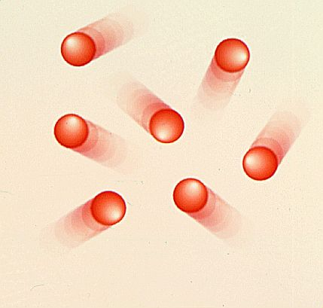
Kinetic Molecular Theory
Assumptions:
Gas particles are constantly in motion
There are no forces of attraction or repulsion between gas particles

Slide 6
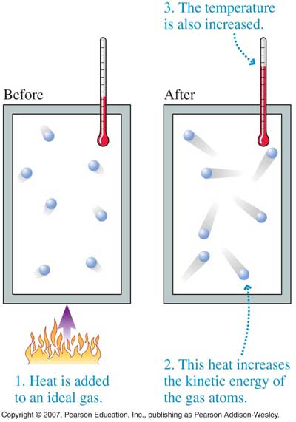
Kinetic Molecular Theory
Assumptions:
5. The kinetic energy of a gas depends on the temperature (as the temp increases the energy/speed increases)
Kinetic Energy-
energy of movement (speed)
Potential Energy-
stored energy

Slide 7
Kinetic Molecular Theory (KMT) and Ideal Gases: A model used to explain the behavior of gases
Note: An IDEAL GAS is THEORETICAL and is used to PREDICT the behavior of REAL GASES. The ASSUMPTIONS above are not true of REAL GASES.

Slide 8
Problems with KMT: Why gases are not ideal…
1. Gas atoms/molecules take up space (they are matter)!
2. Some intermolecular (attractive) forces exist between gas molecules
3. Small volume containers result in more collisions (b/c there’s less space to move) between gas molecules

Slide 9
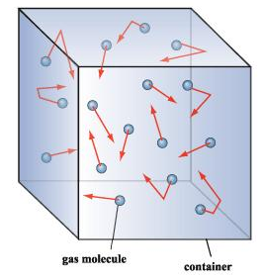
Conditions in which a REAL GAS behaves MOST like an IDEAL GAS:
1. Low pressure (moves around more freely)
2. High temperature (fast moving)
3. Low intermolecular forces (not attracted to each other)
4. Small size
5. Large volume container (more space to move, less likely to collide)

Slide 10
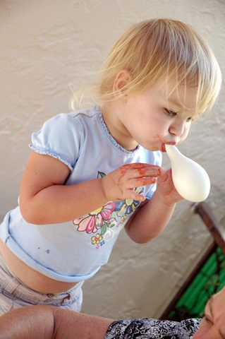
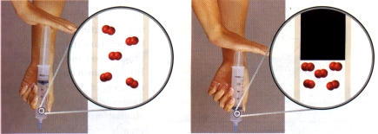
Physical Characteristics of gases:
Gases do not have a definite shape or volume, they expand to fill container
Gases have low density
Gases can be compressed

Slide 11
Variables that Define a Gas
Volume (V) - may be expressed in liters, milliliters, cm³, dm³.
Temperature (T) – Always expressed in Kelvin!!

Slide 12
Variables that Define a Gas
Number of Moles (n) - how many particles are present in the sample of gas
Pressure-the force per unit area on a surface
Exerted by all gases on any surface they collide with
Collisions cause pressure!

Slide 13
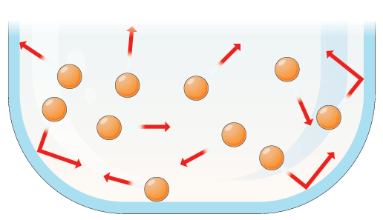
Collisions Cause Pressure

Slide 14
Pressure units:
STANDARD PRESSURE:
1atm = 760mmHg = 760 torr = 101.3 kPa = 1.01x10⁵ Pa

Slide 15
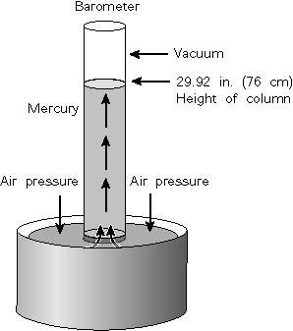
Pressure
Barometer-
used to measure atmospheric (air) pressure
The higher the altitude the __________ the atmospheric pressure and the _________ the height of the mercury in the barometer
lower
lower
Whatever the height is, that is your pressure

Slide 16
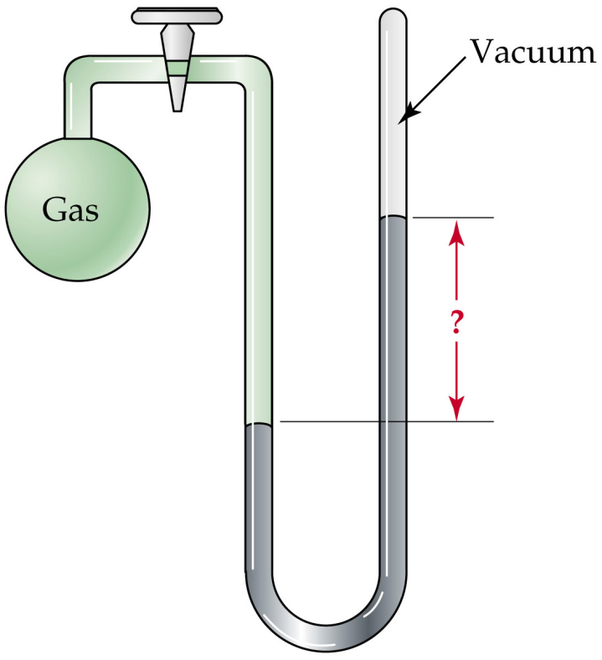
Measuring Pressure of a Gas
Manometer-
measures the pressure of an enclosed sample
Can be open or closed
Closed Manometer

Slide 17
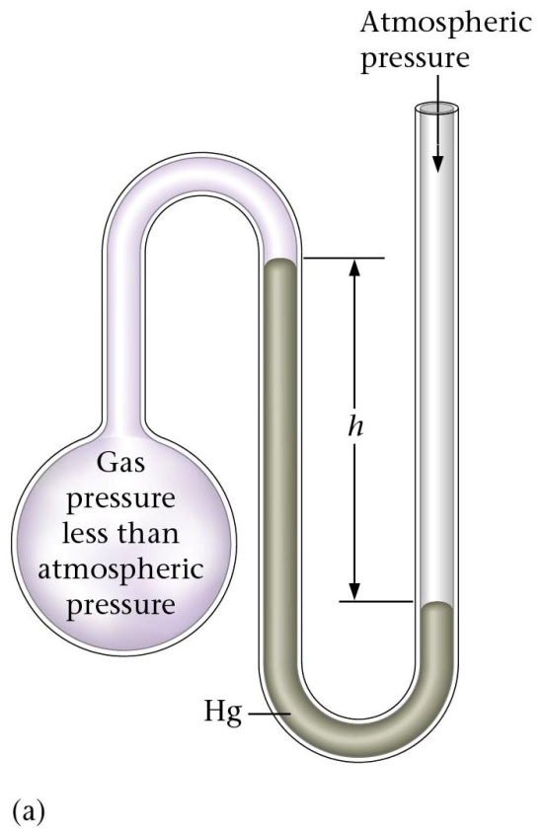
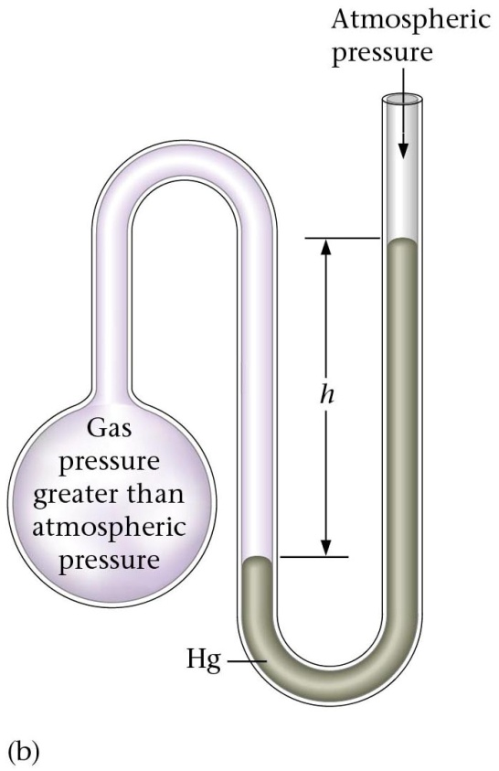
Pressure
Open Manometer
+h
-h
Gas pressure is less than atmospheric pressure when the height of the liquid in the manometer is higher on the _______________. Therefore you will ________________ the height and the atmospheric pressure.
Gas pressure is greater than atmospheric pressure when the height of the liquid in the manometer is higher on the _______________. Therefore you will ________________ the height and the atmospheric pressure.
left side of the U
right side of the U
subtract
add

Slide 18
Examples
1. If the atmospheric pressure is 757.8mmHg, what is the pressure of the gas in each of the following manometers?

