Slide 1
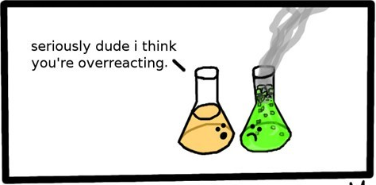
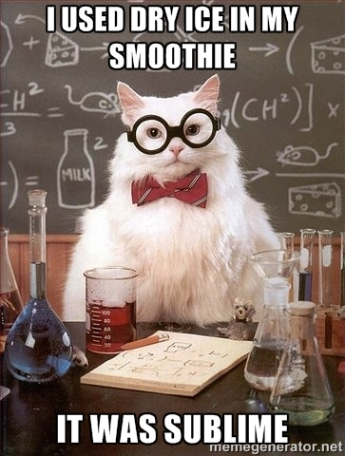
Do Now & Announcements
Turn in Chemical/Physical Changes Lab if you did not do so last class period.

Slide 2
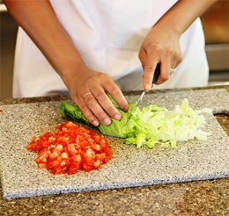
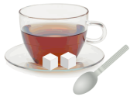
Physical and Chemical Changes
Physical change: a change in which the chemical composition of the substance DOES NOT change.
No new substances are made!
Ex: size/shape change
Phase change (melting, boiling)
dissolving

Slide 3
Physical Changes (cont.)
***NO NEW SUBSTANCES ARE MADE!***
Key Words:
“cut/ground/grind”, “melt”, “freeze”, “evaporate/boil”, “is dissolved in”

Slide 4
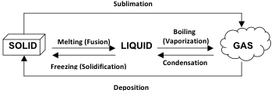
Phase Changes: A Physical Change!
→ Increase Temperature →
← Decrease Temperature ←

Slide 5
Chemical Changes
Chemical Change: a change in which the chemical composition of the substance changes
New substances are made!

Slide 6
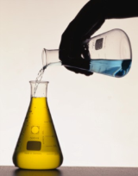
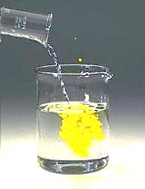
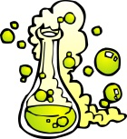
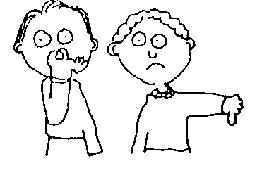
Signs of a Chemical Change (Reaction)
Color Change
Formation of a Precipitate (Solid)
Gas Production
Heat or Light Production
Odor Production

Slide 7
Chemical Changes cont.
***NEW SUBSTANCES ARE MADE!
Key Words:
“react”, “burn”, “corrode”, “rust”, “bubbling”,

Slide 8
Practice
Physical or Chemical Change?
Melting butter
Cutting up food
Digesting food
Grating cheese
Fermenting milk to make cheese
Tearing a piece of aluminum foil

Slide 9
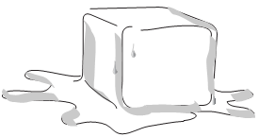
3. Consider an ice cube melting on a countertop
a. Draw arrows showing which direction heat is transferred.
b. When the ice cube melts, is it releasing heat or taking in (absorbing) heat from the surrounding air?
The ice cube is absorbing heat

Slide 10
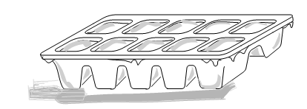
4. Consider water freezing in an ice cube tray:
a. Draw arrows showing which direction heat is being transferred when the ice cube tray is placed in the freezer.
b. When water freezes, is it releasing heat or taking in (absorbing) heat from the environment?
c. In order to cool things in a refrigerator, heat must be transferred away from the food. Where do you think this heat ends up going?
The water is releasing heat
The heat gets transferred out of the refrigerator and into your room!
…this is why it’s a bad idea to try to cool your room down by opening the refrigerator…

Slide 11
Endothermic vs. Exothermic
endothermic=when energy/heat is being absorbed (taken in) in a process
A reaction container will feel COLD due to heat being transferred into (heat is absorbed by) the reaction container
exothermic=when energy/heat is being released (given off) in a process
A reaction container will feel HOT due to heat being transferred out of (heat is released by) the reaction container

Slide 12
The rate of a physical or chemical change depends on the following factors:
Temperature
As the temperature increases, the reaction rate increases (will occur faster)

Slide 13
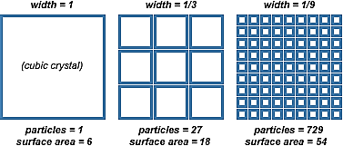
The rate of a physical or chemical change depends on the following factors:
Particle Size:
As the particle size decreases , the reaction rate increases
As the surface area of the reactant increases, the reaction rate increases

Slide 14
The rate of a physical or chemical change depends on the following factors:
Concentration (Molarity):
As the concentration of the reactant increases, the reaction rate increases

Slide 16
The rate of a physical or chemical change depends on the following factors:
Presence of a Catalyst
Catalyst: speeds up the rate of a reaction (but is not a reactant!)
Enzymes are catalysts!

Slide 17
1) Given the balanced equation representing a reaction:
Zn(s) + 2HCl(aq) → H₂(g) + ZnCl₂(aq) Which set of reaction conditions produces H₂(g) at the fastest rate?
a 1.0-g lump of Zn(s) in 50 mL of 0.5 M HCl(aq) at 20 degrees Celsius
a 1.0-g lump of Zn(s) in 50 mL of 0.5 M HCl(aq) at 30 degrees Celsius
1.0 g of powdered Zn(s) in 50 mL of 1.0 M HCl(aq) at 20 degrees Celsius
1.0 g of powdered Zn(s) in 50 mL of 1.0 M HCl(aq) at 30 degrees Celsius

Slide 18
2) At 20°C, a 1.2-gram sample of Mg ribbon reacts rapidly with 10.0 milliliters of 1.0 M HCl(aq).
Which change in conditions would have caused the reaction to proceed more slowly?
increasing the initial temperature to 25°C
decreasing the concentration of HCl to 0.1 M
using 1.2 g of powdered Mg
using 2.4 g of Mg ribbon

Slide 19
Writing Chemical Equations: Representing a physical or chemical change
For chemical changes, there are two terms you need to be familiar with:
Reactants= the substances that you start with in a chemical reaction
Products= the substances that you end up with (produce) in a process/reaction

Slide 20
Chemical Reactions
REACTANTS
PRODUCTS

Slide 21
Symbols for Equations
Symbol | Meaning
+ | Separates two or more reactants or products (“and” or “combine” or “reacts”)
➔ | Separates reactants from products (“yield/produce”)
(s) | Refers to a substance in a solid state
(l) | Refers to a substance in a liquid state
(g) | Refers to a substance in a gaseous state
(aq) | Refers to a substance dissolved in water (aqueous solution)
(NH₄)₂Cr₂O₇(s) ➔ N₂(g) + Cr₂O₃(s) + 4H₂O
reactants
products

Slide 22
Practice Writing Chemical Equations: Don’t forget to include energy/heat is a reactant/product and the phases of each substance! Also, don’t forget about your diatomic elements!
When sodium metal reacts with iron (III) chloride (FeCl₃) powder, iron metal and sodium chloride are formed.
__Na(s) + __FeCl₃(s) → ___Fe(s) + __NaCl(s)
The Haber Process is an exothermic reaction in which nitrogen and hydrogen gas are combined to produce ammonia (NH₃) gas
__ N₂(g) + __ H₂(g) → __ NH₃(g) + heat

Slide 23
Practice Writing Chemical Equations
3) When dissolved barium chloride (BaCl₂) reacts with dissolved potassium sulfate (K₂SO₄) in water, barium sulfate (BaSO₄) precipitates and aqueous potassium chloride (KCl) are made.
4) When sucrose (C₁₂H₂₂O₁₁) burns in oxygen gas, carbon dioxide, water and heat are produced.
5) Hydrogen peroxide (H₂O₂) breaks down to form water and oxygen gas.
6) When dissolved calcium hydroxide (Ca(OH)₂) reacts with sulfuric acid (H₂SO₄), a calcium sulfate (CaSO₄) precipitate is formed along with water and heat
7) When dry ice (CO₂) is placed on a countertop at room temperature, it sublimes.

Slide 24
Types of Reactions

Slide 25
SYNTHESIS
(DIRECT COMBINATION)
Two substances are combined to form a single product.
A + B AB

Slide 26
DECOMPOSITION
A single compound is broken down into more than one product.
AB A + B

Slide 27
COMBUSTION
A compound containing carbon and hydrogen is burned in the presence of oxygen, and the products are carbon dioxide & water vapor.
C_{x}H_{y} + O₂ CO₂ + H₂O

Slide 28
SINGLE REPLACEMENT
An element reacts with a compound. The free element replaces a similar element that is found in the compound.
A + BX AX + B

Slide 29
DOUBLE REPLACEMENT
2 elements of 2 different compounds switch places with one another;
AX + BY AY + BX

Slide 30
NEUTRALIZATION
A double replacement that takes
place when an acid and a base react to form a metal salt and water. (This is also known as an Acid-Base Reaction)
HX + MOH MX + H₂O

Slide 31
Type of Reaction | Chemical Equation
 | 2 NaClO₃ → 2 NaCl + 3 O₂
 | 2 C₆H₁₄ + 19 O₂ → 12 CO₂ + 14 H₂O
 | 2 K + 2 H₂O → 2 KOH + H₂
 | 4 Cr + 3 O₂ → 2 Cr₂O₃
 | Ca(C₂H₃O₂)₂ + Na₂CO₃ →CaCO₃ + 2 NaC₂H₃O₂
 | HCl + NaOH → NaCl + H₂O

