Slide 1
AP Chem
Turn in Shaving Cream Lab if you have not done so yet!
You have until next Friday to finish Unit 2 Corrections.
Today: Phase Changes, IMFs and Properties of Matter

Slide 2
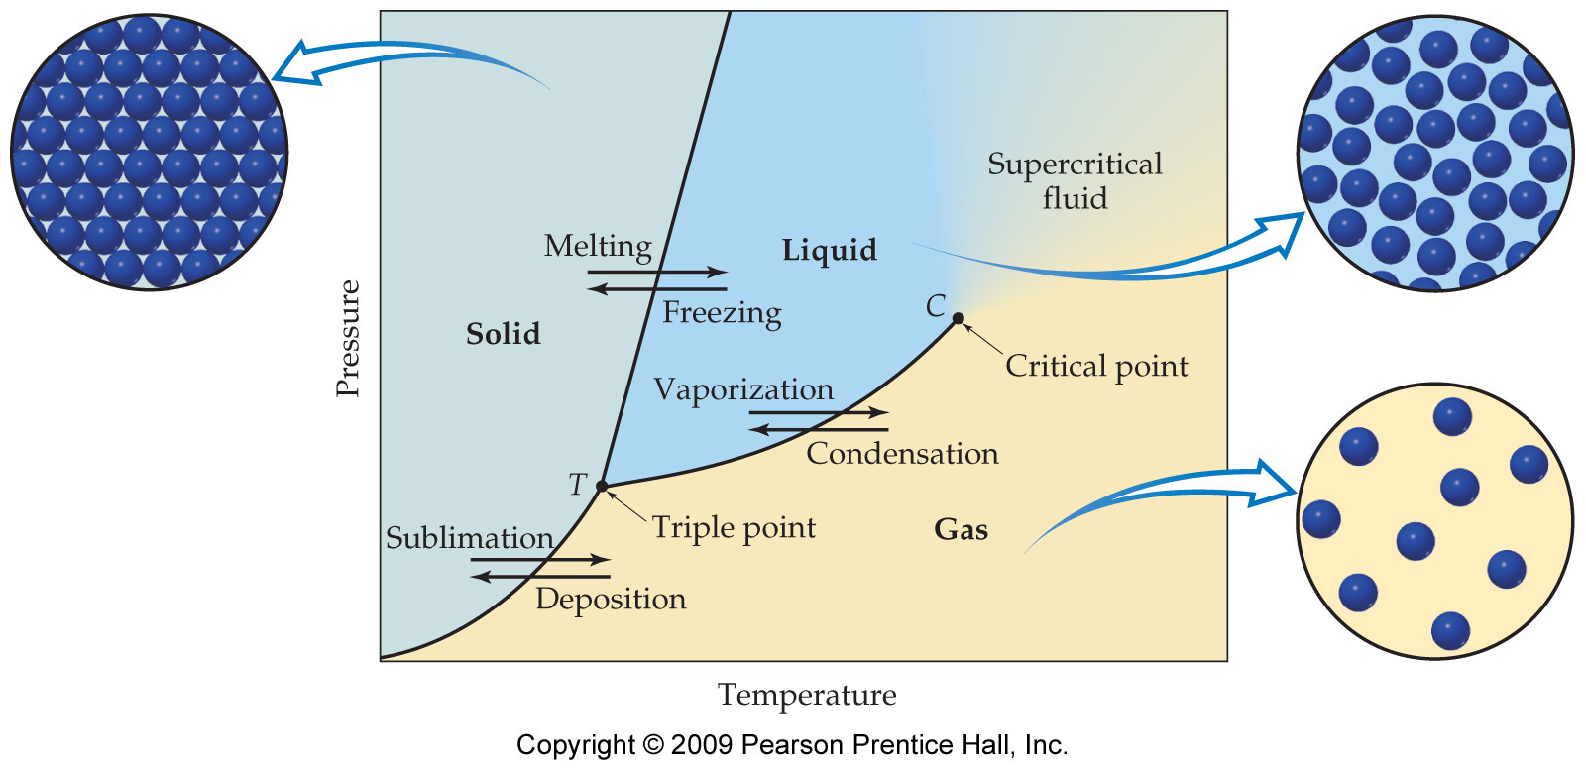
Phase Diagram

Slide 3
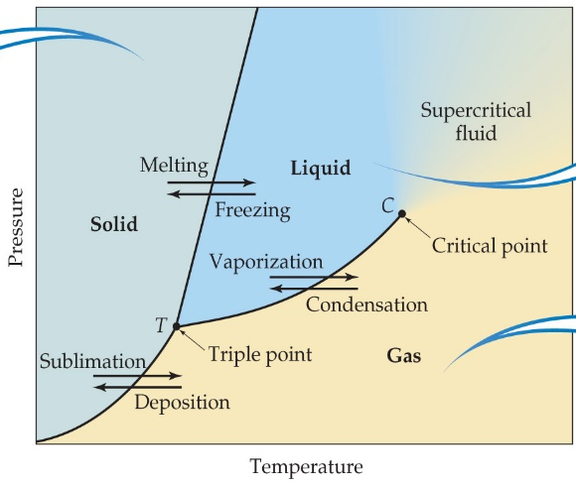
Phase Diagrams
Triple point (T)
The pressure and temperature at which all three states of matter are in equilibrium and coexist.
Critical Point (C)
The highest pressure and temperature in which the liquid and gas can coexist. (it is impossible to liquefy the gas above this temperature no matter what the pressure is)

Slide 4
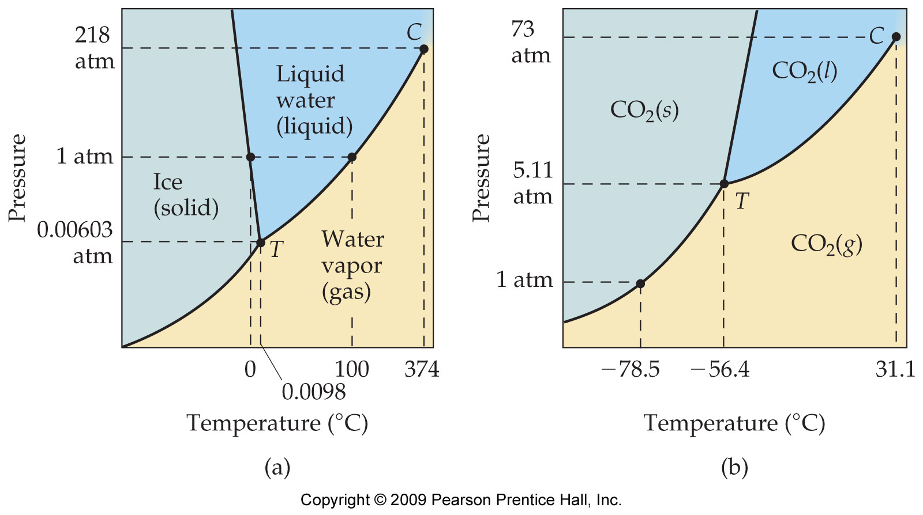
Normal Melting and Boiling Point
Occurs at standard pressure (1 atm)!

Slide 5
Phase Diagram of Water
The slope of the solid-liquid line is negative for water.
  This means that as the pressure is increased at a temperature just below the melting point, water goes from a solid to a liquid.
Note the high critical temperature and critical pressure.
  These are due to the strong IMFs (specifically, hydrogen bonding) between water molecules.

Slide 6
Negative slope for the solid-liquid line (like in water): solid is less dense than the liquid
Positive slope for the solid-liquid line: solid is more dense than the liquid

Slide 7
Phase Diagram of Carbon Dioxide
Carbon dioxide cannot exist in the liquid state at pressures below 5.11 atm; CO₂ sublimes at normal pressures.

Slide 8
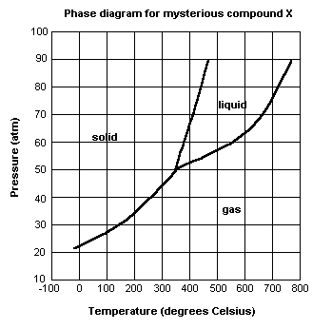
Practice

Slide 9
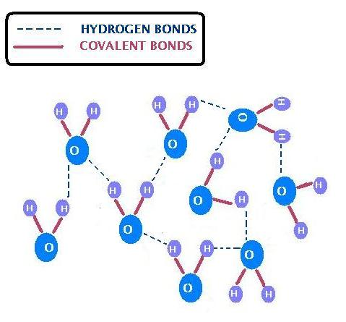
Intermolecular Forces
Forces of attraction between molecules
(dotted lines represents attraction between molecules)

Slide 10
Intermolecular Forces
In general, for the same chemical substance, molecules in the solid phase will have stronger intermolecular forces between them than molecules in the gas phase
In order for a substance to melt or boil (change phase), enough energy must be supplied so that the molecules may overcome the intermolecular forces holding them together.

Slide 11
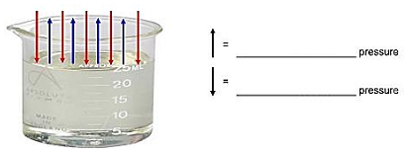
Pressure:
Atmospheric Pressure=pressure exerted by the air above a surface
Vapor Pressure=pressure exerted by the molecules at the surface of the liquid that are escaping into the gas phase
VAPOR
ATMOSPHERIC

Slide 12
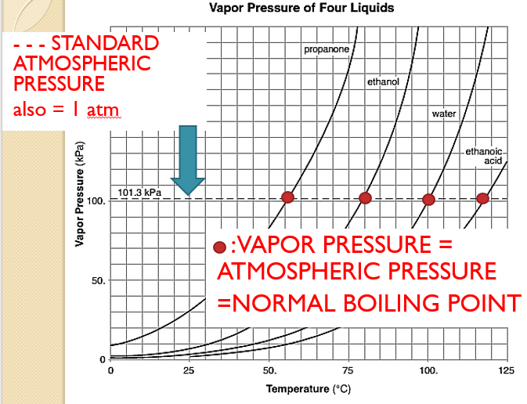
Boiling point of a liquid:
vapor pressure = atmospheric pressure

Slide 13
Properties of Liquids Demos

Slide 14
Review: Solutions
Solutions are homogeneous mixtures that may be solid, liquid, or gaseous.
Solute vs. Solvent
The solute is what is being dissolved.
The solvent is what is doing the dissolving

Slide 15
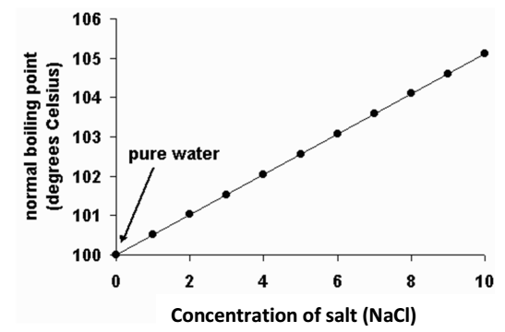
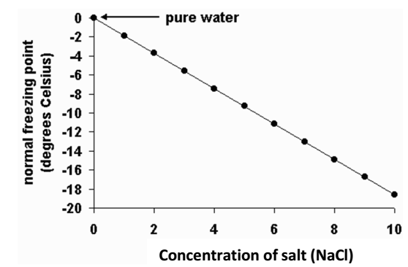

Slide 16
Why do you think people pour salt on the roads/sidewalks in the winter?
Why do you think people add salt to water when making pasta?

Slide 17
Colligative Properties
The addition of a solute to a solvent causes the boiling point of the solvent to increase . This phenomenon is known as boiling point elevation
The addition of a solute to a solvent causes the freezing point of the solvent to decrease. This phenomenon is known as freezing point depression
The higher the concentration of solute particles, the greater the effect.

Slide 18
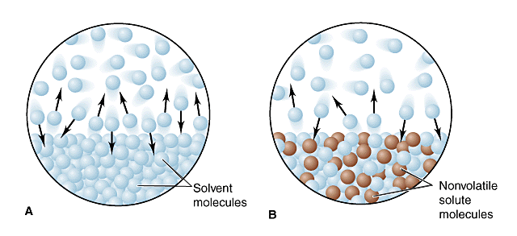
Why does this happen?
When a solute is dissolved in a solvent, the vapor pressure of the resulting solution will be lower than the vapor pressure of the pure solvent.
When a solvent is pure, its particles occupy the entire surface area. However, when a solute is added, a mix of solvent and solute particles occupy the surface area.
With fewer solvent particles at the surface, fewer particles enter the gaseous state, and the vapor pressure is lowered.

Slide 19
Recall that boiling occurs when the vapor pressure from the surface of the liquid is equal to the air pressure pushing down on the surface.
If adding a solute lowers the vapor pressure, the solution must be heated to a higher temperature in order to make the
VP = AP

Slide 20
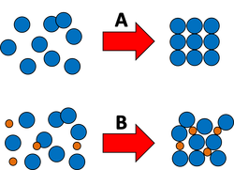
Freezing Point Depression
Freezing: the solute particles get in the way of the pure substance’s ability to form a solid structure (i.e. water forming ice crystals)
A= Pure Substance
B = Substance w/ solute particles added

