Slide 1
Agenda
Take Macromolecules Quiz
Enzymes Mini-Lesson
Work on Project (shared with you on google drive)-due MON 10/24
Helpful link for digestion part of project: http://kitses.com/animation/swfs/digestion.swf
Unit 2 Test WED 10/26
Extra Credit due by day of test!

Slide 2
Enzymes
Part of the protein family of macromolecules
Main role is to speed up reactions that otherwise occur too slowly on their own
Bind to the reactants (known as substrates) but enzymes do not get used up or changed in the reaction

Slide 3
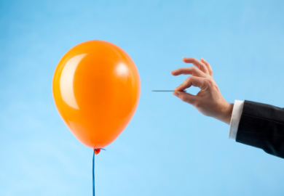
Enzymes: An analogy
Balloon is losing air by itself (slow process)
Needle (enzyme) catalyzes this process, or makes it go faster.

Slide 4
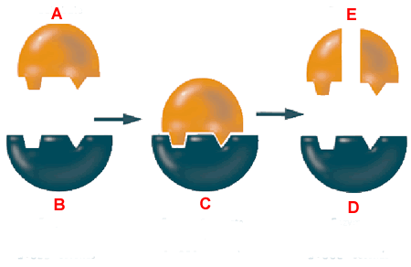
Practice
Which of these letters (A-E) represent the enzyme? What is the enzyme doing?
Which of these letters (A-E) represent the reactant?
Which of these letters (A-E) represent the product?

Slide 5
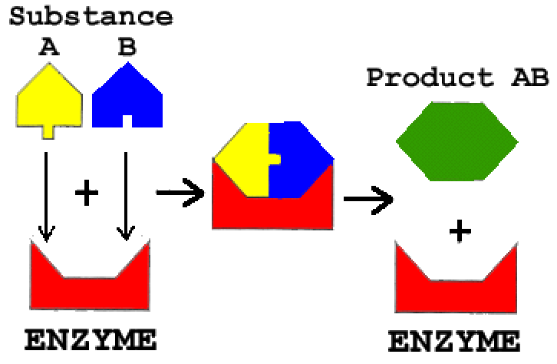
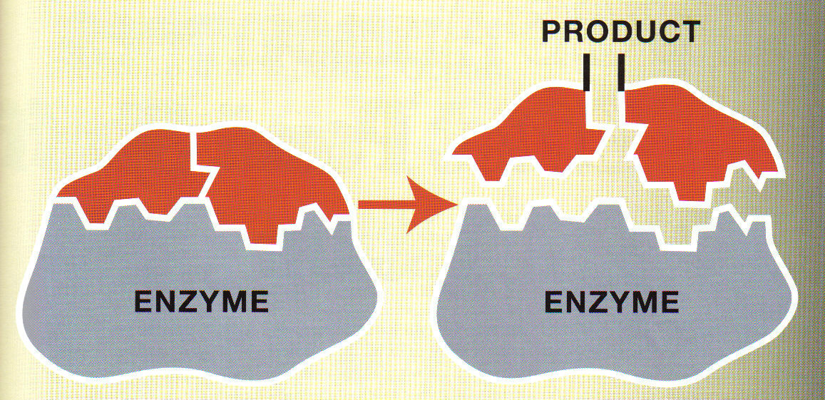
Enzymes
Which picture (A or B) represents an enzyme catalyzing a dehydration synthesis reaction?
Which picture (A or B) represents an enzyme catalyzing a hydrolysis reaction (digestion)?

Slide 6
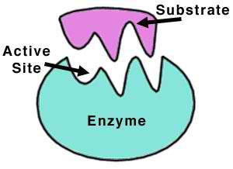
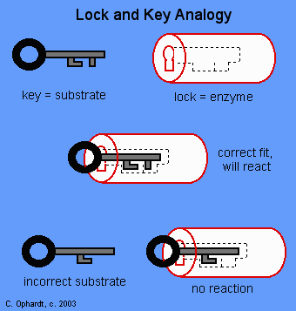
Enzymes work like a lock and key
The lock = enzyme
The key = substrate
Substrate: molecule or molecules an enzyme works on
The lock and key come together at the active site

Slide 7
CARBOHYDRATES (STARCH)
MOUTH, SMALL INTESTINE
LIPIDS (FATS)
SMALL
INTESTINE
PROTEINS
STOMACH, SMALL INTESTINE

Slide 8
Answer Enzymes Summary Questions

