Slide 1
Chemistry
Use your laptop and go to bit.ly/SolutionPhet
Use the simulation to answer the questions on the front of today’s handout.
I will go over the back with you.
Whole sheet needs to be stamped off!
Unit 2 Test Wed 10/3

Slide 2
HOMOGENEOUS
solvent is water

Slide 3
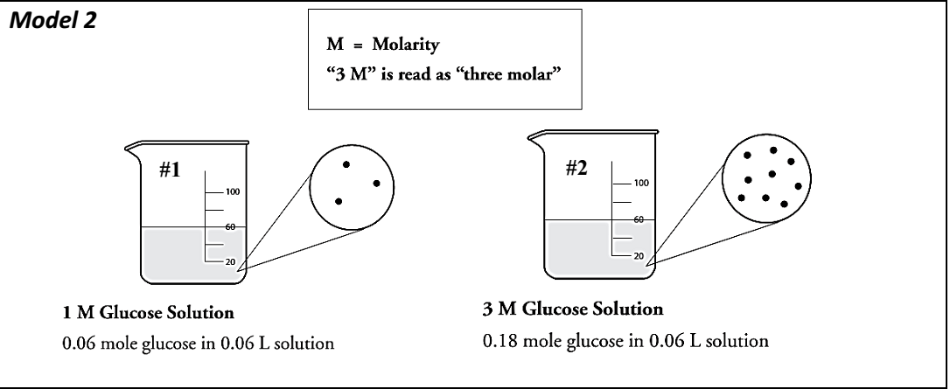

Slide 4
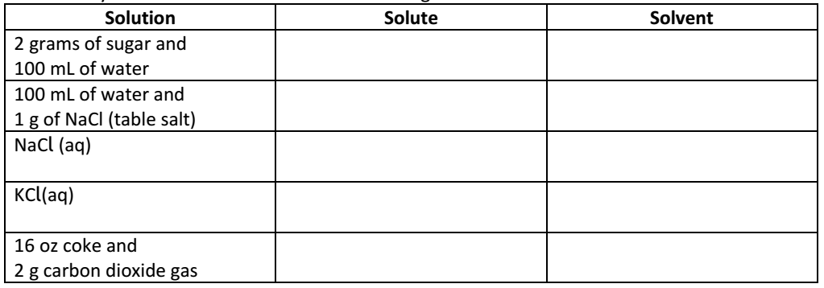
Solutions: Solute vs. Solvent
sugar
water
salt
water
NaCl
water
KCl
water
CO₂
coke

Slide 5
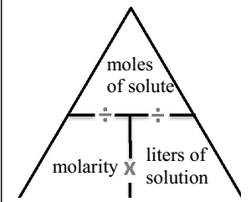
Formula for Molarity (M)

Slide 6
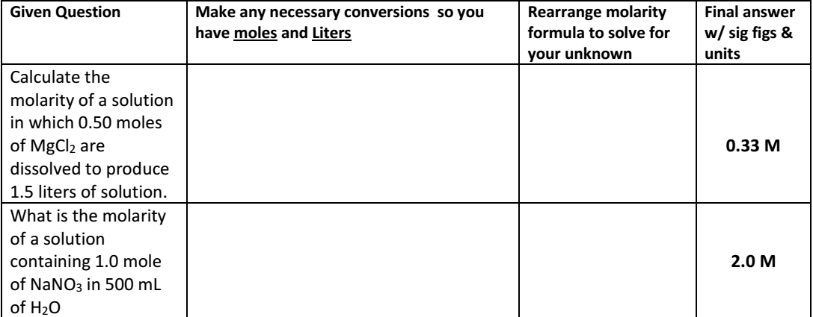
None needed
$$\frac{0.5 mol}{1.5 L}$$
$500 mL ×\frac{1 L}{1000 mL}$=0.5 L
$$\frac{1.0 mol}{0.5 L}$$

