Slide 1
Do Now & Announcements
Keep your periodic table out for today. This is the only copy you’ll be getting from me!
Today: Classification of Matter
If needed: finish right half of mini-lab for HW
Unit 1 Test: If you got below an A, you can come in before school/during MM next week to start working on test corrections

Slide 2
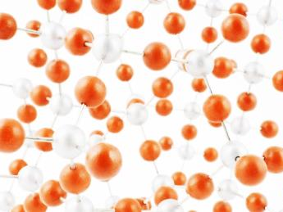
So what is chemistry?
Chemistry is the study of the properties and interactions of matter
Matter=anything that has mass and takes up space
Atom=the smallest, simplest unit of matter
Atoms can combine or join together to form other substances:

Slide 3
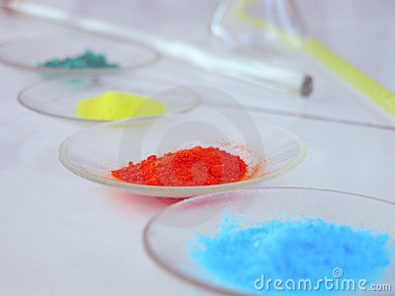
Classification of Matter

Slide 4
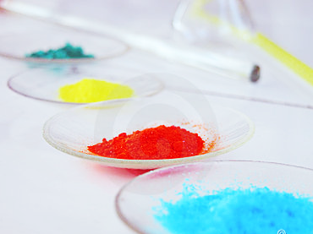
Pure Substances
Pure Substance=a substance that CANNOT be physically broken down. It can be separated by a chemical process ONLY
Element=a substance that is made up of only one type of atom
Elements CANNOT be broken down (decomposed) into simpler substances
All the elements that we know of are organized in the periodic table of elements

Slide 5
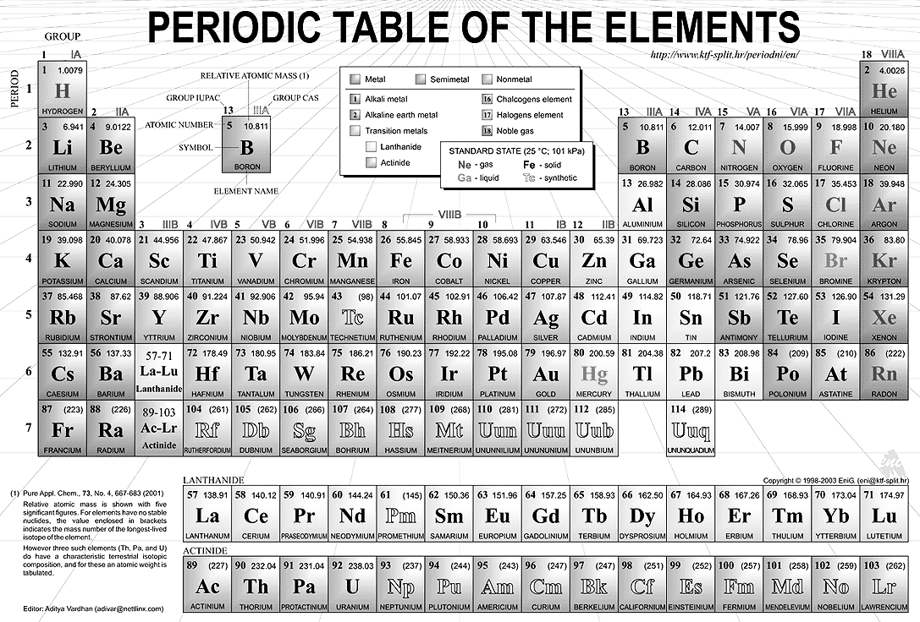
*All element symbols start with a capital letter!
YOU SHOULD BE FAMILIAR WITH THE FIRST 18 ELEMENTS! (SYMBOL + NAME)

Slide 6
Diatomic Elements
2 atoms of the same type bonded together
H₂, N₂, O₂, F₂, Cl₂, Br₂, I₂…or “7 UP”

Slide 7
Pure Substances Cont.
Compound= a substance that is made up of 2 or more types of atoms.
Therefore, a compound is made up of 2 or more elements in a specific ratio or proportion.
Compounds can be chemically separated (decomposed) into the elements that make it up.

Slide 8
Carbon atoms
element
Sodium atoms
and Chlorine atoms
compound
Carbon, hydrogen, and oxygen atoms
compound
Lithium atoms
element

Slide 9
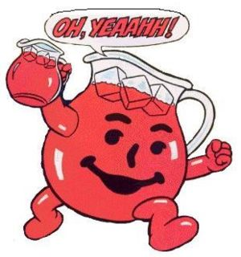
Pure Substances vs. Mixtures
Pure Substances=substances that cannot be physically separated into simpler substances
Mixture=a combination of 2 or more substances that can be physically separated into their individual parts without changing what they are
Mixtures can be made up of elements, compounds, or both.

Slide 10
Mixtures: “Salad”
homogeneous mixture=a mixture in which the particles are uniformly (evenly) spread
the individual substances making up the mixture cannot be easily seen
Most common type: solution
Ex: sugar dissolved in water; atmospheric air

Slide 11
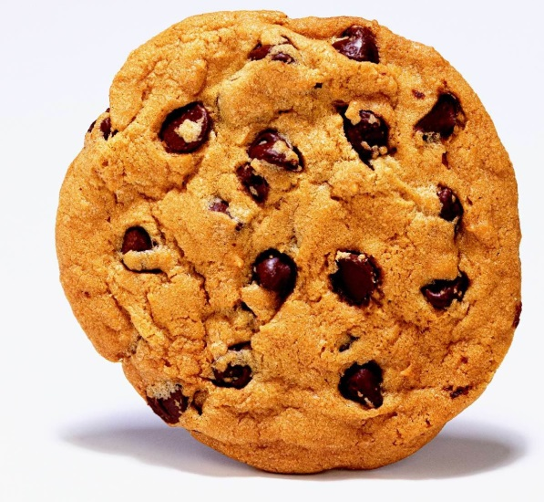
Mixtures
2. heterogeneous mixture=a mixture in which the particles are not uniformly spread
the individual substances making up the mixture can be easily seen
Ex: chocolate chip cookie, sand in water, salad

Slide 12
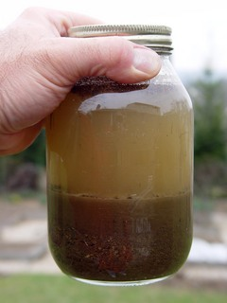
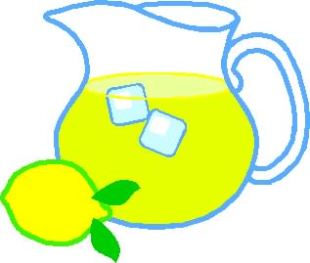
What do I mean by “uniformly spread”???
Consider a container of lemonade vs. a container of sand and water
Heterogeneous mixture: particles are NOT uniformly spread—you won’t get exactly the same stuff depending on where you take the sample from
Homogeneous Mixture: particles are uniformly spread--You get the same stuff no matter where you take the sample from

Slide 13
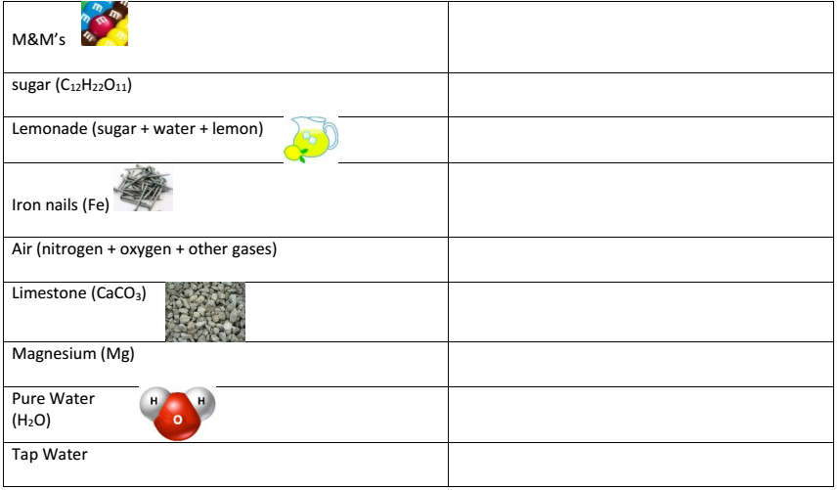
mixture
compound
mixture
element
mixture
compound
element
compound
mixture

Slide 14
v
Pure substance —compound
Pure substance —element
Pure substance: diatomic element
mixture

Slide 15
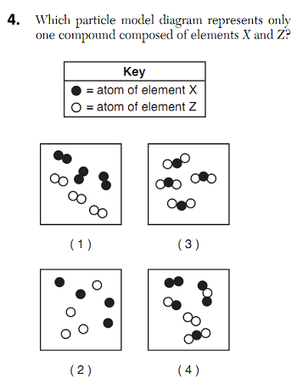

Slide 16
Classification of Matter Mini-Lab
Tear off, turn in.

