Slide 1
AP Chem
Unit 1 Test Corrections (and make-up work) due by next Thursday
Today: Gas Behavior and Gas Laws Review
Bring in empty/clean soup can you’d feel comfortable eating out of for Friday.
Sign up for ice cream materials for lab next week

Slide 2
Kinetic Molecular Theory
Explains properties of gases, liquids, and solids in terms of energy using an ideal gas, an imaginary gas which fits all the assumptions of kinetic molecular theory

Slide 3
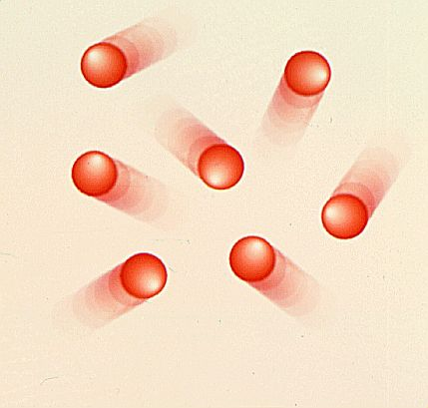
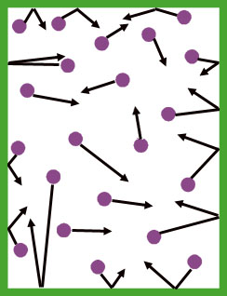
Kinetic Molecular Theory
Assumptions:
Gas particles are in continuous, rapid, random motion
The size of the gas particles is negligible compared to the distance between gas particles. Therefore, gases are mostly empty space
There are no attractive or repulsive forces between gas particles.

Slide 4
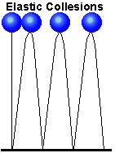
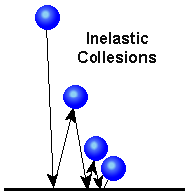
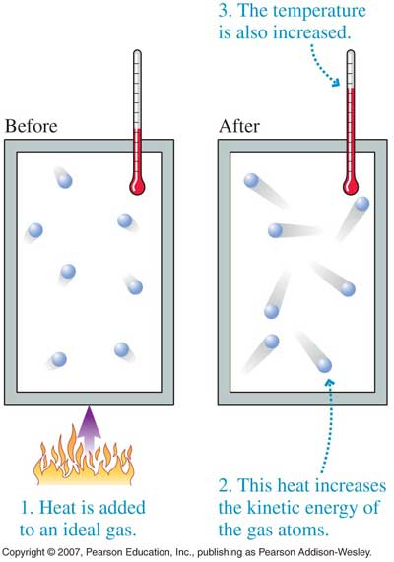
Kinetic Molecular Theory
Elastic collisions occur between molecules during collisions, meaning there is no loss of kinetic energy during collisions
The average kinetic energy of the molecules is proportional to the absolute temperature of the gas.
Note: An IDEAL GAS is THEORETICAL and is used to PREDICT the behavior of REAL GASES. The ASSUMPTIONS above are not true of REAL GASES.

Slide 5
Problems with KMT: Why gases are not ideal…
1. Gas atoms/molecules take up space (they are matter)!
2. Some intermolecular (attractive) forces exist between gas molecules
3. Small volume containers result in more collisions (b/c there’s less space to move) between gas molecules

Slide 6
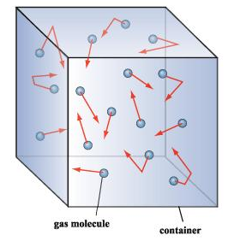
Conditions in which a REAL GAS behaves MOST like an IDEAL GAS:
1. Low pressure (moves around more freely)
2. High temperature (fast moving)
3. Low intermolecular forces (not attracted to each other)
4. Small size
5. Large volume container (more space to move, less likely to collide)

Slide 7
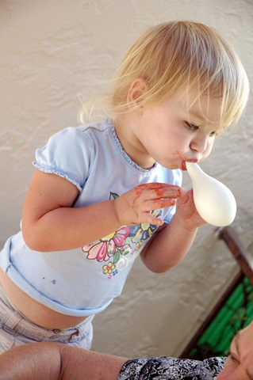
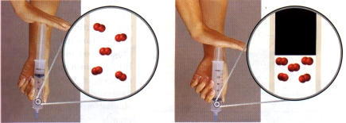
Physical Characteristics of gases:
Gases do not have a definite shape or volume, they expand to fill a container
Gases have low density
Gases can be compressed

Slide 8
Variables that Define a Gas
Volume (V) - may be expressed in liters, milliliters, cm³, dm³.
Temperature (T) – Always expressed in Kelvin!!

Slide 9
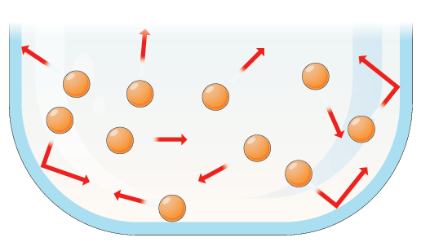
Variables that Define a Gas
Number of Moles (n) - how many particles are present in the sample of gas
Pressure-the force per unit area on a surface
Exerted by all gases on any surface they collide with
Collisions cause pressure!

Slide 10
Pressure units:
STANDARD PRESSURE:
1atm = 760mmHg = 760 torr = 101.3 kPa = 1.01x10⁵ Pa

Slide 11
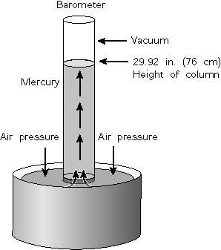
Measuring Pressure: Barometer
used to measure atmospheric (air) pressure
The higher the altitude the lower the atmospheric pressure and the lower the height of the mercury in the barometer
Whatever the height is, that is your pressure

Slide 12
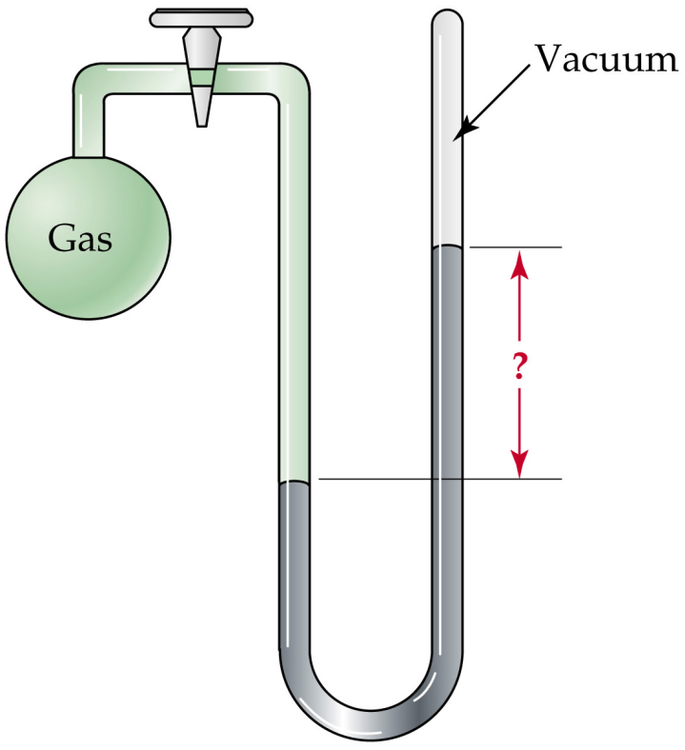
Measuring Pressure of a Gas
Manometer-
measures the pressure of an enclosed sample
Can be open or closed
Closed Manometer

Slide 13
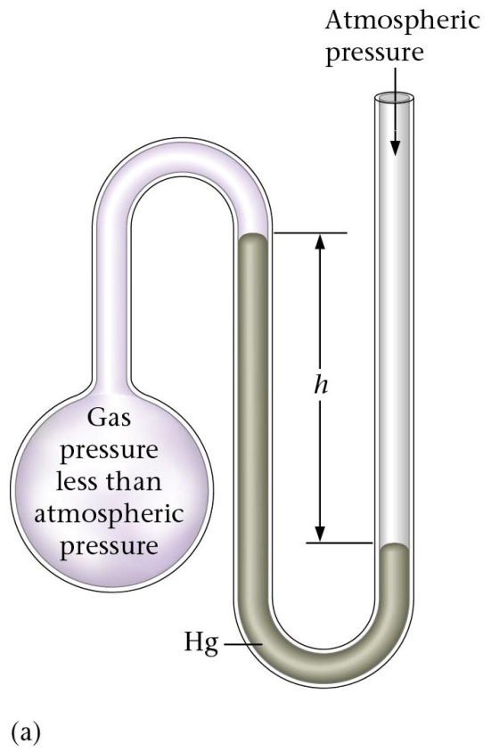
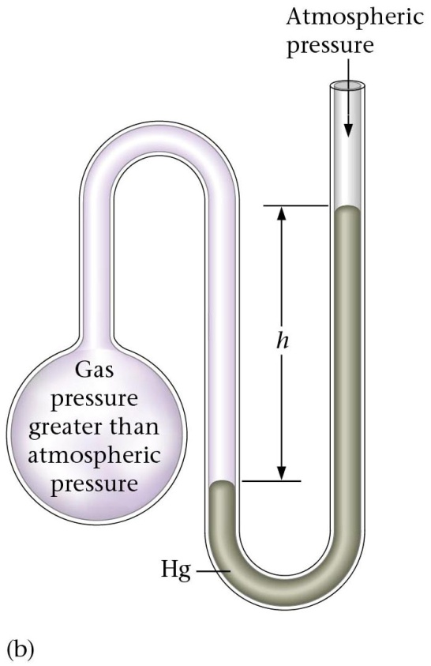
Pressure
Open Manometer
+h
-h
Gas pressure is less than atmospheric pressure when the height of the liquid in the manometer is higher on the _______________. Therefore you will ________________ the height and the atmospheric pressure.
Gas pressure is greater than atmospheric pressure when the height of the liquid in the manometer is higher on the _______________. Therefore you will ________________ the height and the atmospheric pressure.
left side of the U
right side of the U
subtract
add

Slide 14
Examples
1. If the atmospheric pressure is 757.8mmHg, what is the pressure of the gas in each of the following manometers?

Slide 15
Gas Laws Summary Table
Name of Law | Equation/Definition | Type of Relationship | Constant
Dalton’s Law |  | ---- | ----
Graham’s Law |  |  | ----
Boyle’s Law |  |  | T
*Charles’ Law |  |  | P
*Gay-Lussac’s Law |  |  | V
*Combined Gas Law |  | ---- | ----
Avogadro’s Law |  |  | ----
*Ideal Gas Law |  | ----

Slide 16
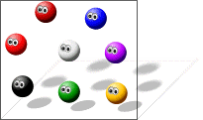
Dalton’s Law
each individual gas behaves as if it were independent of the others.
the total pressure exerted by a mixture of gases is the sum of the individual pressures of each gas
P_{total} = P₁ + P₂ + P₃ + …

Slide 17
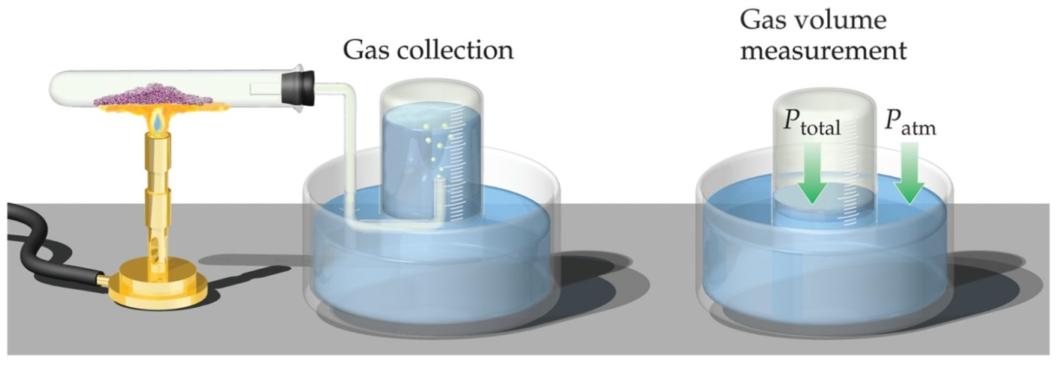
Partial Pressures
When one collects a gas over water, there is water vapor mixed in with the gas.
To find only the pressure of the desired gas, one must subtract the vapor pressure of water from the total pressure
P_{total} = P_{gas} + P_{H2O}
Value depends on temperature

Slide 18
Partial Pressures and Mole Fraction
The mole fraction of an individual gas component in an ideal gas mixture can be expressed in terms of the component's partial pressure or the moles of the component:
The partial pressure of an individual gas component in an ideal gas can be obtained using this expression:

Slide 19
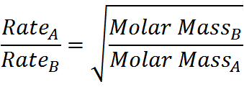
Graham’s Law of Diffusion
Under ideal conditions, the rates at which different gases diffuse (spread out) are inversely proportional to their molar masses.

Slide 20
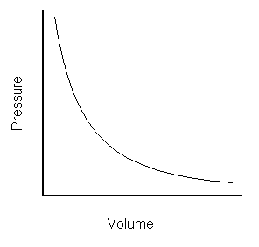
Boyle’s Law
P₁V₁= P₂V₂
Inversely proportional
Molecular explanation: decreasing volume reduces the amount of space gas molecules have to move → increases the # of collisions → increases the pressure

Slide 21
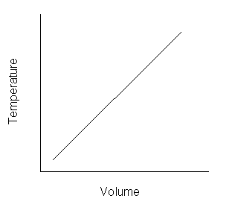
Charles’s Law
$\frac{V1}{T1}=\frac{V2}{T2}$
Directly proportional
Temperature must be in Kelvin!
Molecular explanation: increasing temperature causes the gas molecules to move faster (↑ kinetic energy) → molecules hit the container with more force → causes container to expand

Slide 22
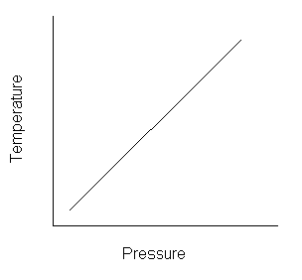
Gay-Lussac’s Law
$\frac{P1}{T1}=\frac{P2}{T2}$
Directly Proportional
Temperature must be in Kelvin!!
Molecular explanation: increasing temperature causes the gas molecules to move faster (↑ kinetic energy) → molecules collide more frequently → pressure increases

Slide 23
Combined Gas Law
Relates pressure, temperature, and volume in one equation

Slide 24
STP
STP= Standard Temperature & Pressure
273 K & 1 atm

Slide 25
Avogadro’s Law
$\frac{n_{1}}{V_{1}}=\frac{n_{2}}{V_{2}}$ (n = # of moles)
The volume of a gas at constant temperature and pressure is directly proportional to the number of moles of the gas.
Equal volumes of gases at the same pressure and temperature contain the same # of moles and molecules
1 mole of any gas at STP is 22.4L

Slide 26
Ideal Gas Law
Describes the state of a hypothetical ideal gas.
Good approximation of the behavior of many gases under many conditions.
PV=nRT
n= # moles
R=universal gas constant
Will be GIVEN on tests/quizzes!
R is the universal gas constant.
To determine which R to use in your equation you have to look at the _____________.
Pressure units being used!!

