Slide 1
Do Now
Work on “characteristics of life do now”
Today: Homeostasis
Quiz Wed 9/14: Sci. Method & Characteristics of Life
Characteristics of Life Project due FRI 9/16
Share your project with me via google slides: kye@k12albemarle.org

Slide 3
Homeostasis
A dynamic process of regulating and maintaining stable internal conditions
For many organisms, the main players in maintaining homeostasis are the nervous system and the endocrine system

Slide 4
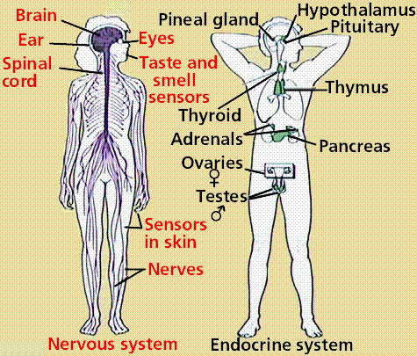
Nervous system: made up of nerve cells, transmits nerve messages throughout the body
Endocrine system: made up of glands, produces and transports hormones throughout the body

Slide 5
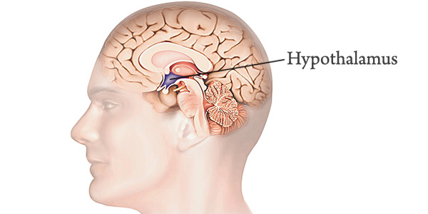
Hypothalamus: a gland located in the middle of the brain that acts as the “control center” . When it senses that homeostasis has been disturbed, it sends signals to other parts of your body to adjust

Slide 6
Negative Feedback (more common):
Results in a decrease of a substance/process that is currently too high in the body, and vice versa. (results in an increase of a substance/process that is currently too low in the body)

Slide 7
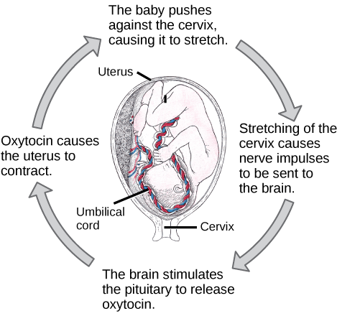
Positive Feedback
Results in a continued increase of a substance/process that is currently already high in the body.

Slide 8
Homeostasis Game: Groups of 4
In your group, decide who will be the hypothalamus. The rest of group will be a Body
Each Body starts with 5 Body cards (1 of them should be a temperature baseline card) and 2 life tokens
Starting Homeostasis Number is 5 points
For each round:
Hypothalamus plays 1 orange card at the beginning of each round.
Body players will react to the hypothalamus card being played. To do so, body players must discard a card into the discard pile and pick up a new card for each round.
GOAL: Be as close to the homeostasis number as possible to stay alive. Don’t lose your life tokens!

Slide 9
Things to be completed
Homeostasis Questions (for the game and hw)
Quiz next class period
Project due FRIDAY

