Slide 1
AP Chem
Take out HW to be checked
Start working on combustion analysis problems
Today: Combustion Analysis and Stoichiometry Review
Unit 1 Test next Thurs 9/13 and Fri 9/14

Slide 2
EF/MF HW Answers
C₃H₄O₃
C₄H₆O, C₈H₁₂O₂
C₁₄H₁₈N₂O₅
C₈H₁₀N₄O₂
C₅H₁₄N₂
C₇H₅N₃O₆ , C₇H₅N₃O₆

Slide 3
Combustion Analysis
1
1
1
2
3
5
1
2
3
2
2
4
Coefficient of CO₂ = subscript on C in the reactant hydrocarbon
moles of C atoms in hydrocarbon = moles of CO₂ produced
Coefficient of H₂O = ½ of subscript on H in reactant
moles of H atoms in hydrocarbon = 2x moles of H₂O produced
If hydrocarbon contains another element (such as nitrogen or oxygen), the law of conservation of mass must be applied

Slide 4
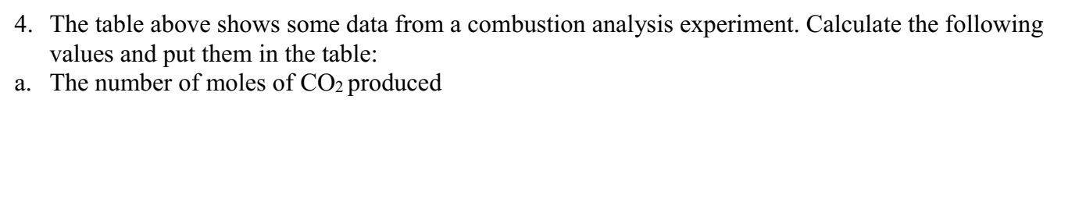
Mass of CO₂ produced | Moles of CO₂ produced | Moles of C atoms in unknown | Mass of H₂O produced | Moles of H₂O produced | Moles of H atoms in unknown | C : H atoms in unknown | Empirical Formula of Unknown
27.42 g | 0.623 | 0.623 | 22.46 g
27.42 g CO₂
1 mol CO₂
=0.623 mol CO₂
44.01 g CO₂
=0.623 mol C

Slide 5
Mass of CO₂ produced | Moles of CO₂ produced | Moles of C atoms in unknown | Mass of H₂O produced | Moles of H₂O produced | Moles of H atoms in unknown | C : H atoms in unknown | Empirical Formula of Unknown
27.42 g | 0.623 | 0.623 | 22.46 g | 1.246 | 2.493
22.46 g H₂O
1 mol H₂O
=1.246 mol H₂O
18.02 g H₂O
1.246 x 2
= 2.493 mol H

Slide 6
Mass of CO₂ produced | Moles of CO₂ produced | Moles of C atoms in unknown | Mass of H₂O produced | Moles of H₂O produced | Moles of H atoms in unknown | C : H atoms in unknown | Empirical Formula of Unknown
27.42 g | 0.623 | 0.623 | 22.46 g | 1.246 | 2.493 | 1: 4 | CH₄
0.623 mol C
2.493 mol H
CH₄
1 mol C : 4 mol H
Molar mass

Slide 7
Mass of CO₂ produced | Moles of Carbon atoms in unknown | Mass of H₂O produced | Moles of Hydrogen atoms in unknown | Total Mass of C and H atoms in unknown | Mass of O atoms in unknown | Moles of O atoms in unknown | Empirical Formula of Unknown
19.10 g | 0.434 | 11.73 g | 1.302
19.10 g CO₂
1 mol CO₂
1 mol C
= 0.434 mol C
44.01 g CO₂
1 mol CO₂
11.73 g H₂O
1 mol H₂O
2 mol H
= 1.302 mol H
18.02 g H₂O
1 mol H₂O

Slide 8
Mass of CO₂ produced | Moles of Carbon atoms in unknown | Mass of H₂O produced | Moles of Hydrogen atoms in unknown | Total Mass of C and H atoms in unknown | Mass of O atoms in unknown | Moles of O atoms in unknown | Empirical Formula of Unknown
19.10 g | 0.434 | 11.73 g | 1.302 | 6.527
0.434 mol C
12.01 g C
=5.212 g C
1 mol C
=6.527 g C +H
1.302 mol H
1.01 g H
=1.315 g H
1 mol H

Slide 9
Mass of CO₂ produced | Moles of Carbon atoms in unknown | Mass of H₂O produced | Moles of Hydrogen atoms in unknown | Total Mass of C and H atoms in unknown | Mass of O atoms in unknown | Moles of O atoms in unknown | Empirical Formula of Unknown
19.10 g | 0.434 | 11.73 g | 1.302 | 6.527 | 3.473 | 0.217
10 g sample - 6.527 g C +H = 3.473 g O
3.473 g O
1 mol O
=0.217 mol O
16 g O

Slide 10
Mass of CO₂ produced | Moles of Carbon atoms in unknown | Mass of H₂O produced | Moles of Hydrogen atoms in unknown | Total Mass of C and H atoms in unknown | Mass of O atoms in unknown | Moles of O atoms in unknown | Empirical Formula of Unknown
19.10 g | 0.434 | 11.73 g | 1.302 | 6.527 | 3.473 | 0.217 | C₂H₆O
0.434 mol C
1.302 mol H
0.217 mol O
/0.217
/0.217
/0.217
= 2 mol C
= 6 mol H
= 1 mol O

Slide 11
Combustion Analysis Practice Problems
CH₃
CH
CH₂O
a) C₃H₂O b) C₆H₄O₂

Slide 12
Stoichiometry Review
Start with your “given” value and convert to the substance you’re trying to find
Include your units when setting up the dimensional analysis problem
Remember, the coefficients in the balanced equation tells you the relative number of moles of substance

Slide 13
$$74.00 g Al$$
$$1 mol Al$$
$$2 mol{ Al}_{2}O_{3}$$
$$101.96 g{ Al}_{2}O_{3}$$
$$26.98 g Al$$
$$4 mol Al$$
$$1 mol{ Al}_{2}O_{3}$$
$$139.8 g{ Al}_{2}O_{3}$$

Slide 14
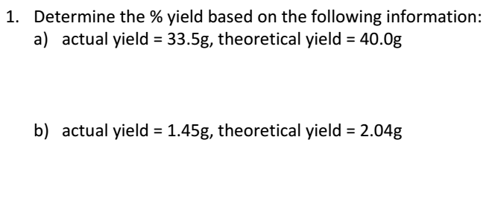
$$\frac{33.5 g}{40.0 g}×100$$

Slide 15
Add to note sheet:
Limiting Reactant-what you have LESS of. Determines how much product you can make.
Excess Reactant-what you have EXTRA of.

Slide 16
$$21. 6 g C3H6$$
$$×\frac{1 mol C3H6}{42.09 g C3H6}$$
$$×\frac{4 mol C3H3N}{4 mol C3H6}$$
$$×\frac{53.07 g C3H3N}{1 mol C3H3N}$$
=27.23 g C₃H₃N
$$21. 6 g NO$$
$$×\frac{1 mol NO}{30.01 g NO}$$
$$×\frac{4 mol C3H3N}{6 mol NO}$$
$$×\frac{53.07 g C3H3N}{1 mol C3H3N}$$
=25.5 g C₃H₃N
25.5 g C₃H₃N
LIMITING: NO EXCESS: C₃H₆
$$\frac{23.5 g}{25.5 g}×100$$

Slide 17
Theoretical Yield, Limiting Reactant Practice
Theoretical Yield Values (part b):
13.75 g,
8.51 g

Slide 18
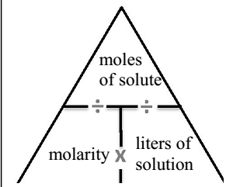
Formula for Molarity (M)

Slide 19
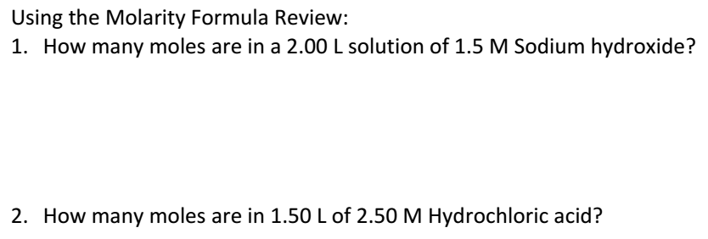

Slide 20
Use Molarity equation to find MOLES!
$$\# moles=Molarity ×Liters$$
$$0.875 mol HCl=$$
3.50 M x 0.25 L
$$×\frac{1 mol NaCl}{1 mol HCl}$$
$$×\frac{58.44 g NaCl}{1 mol NaCl}$$
$$0.875 mol HCl$$
$$=51.1 g NaCl$$

Slide 21
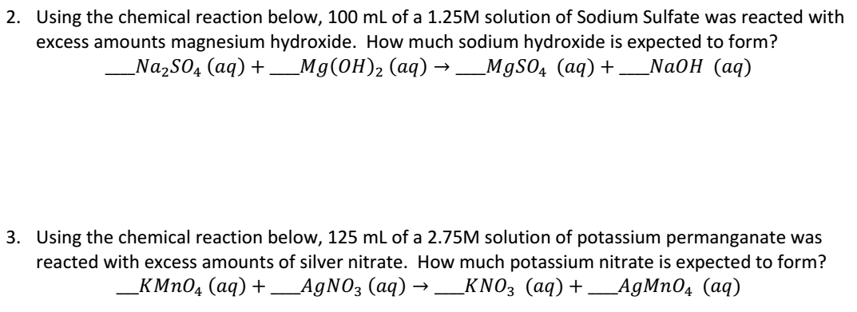
$$10 g NaOH$$
$$34.8 g KNO3$$

