Slide 1
Chem
Turn in Unit Conversions Mini-Lab if you did not do so on Friday.
Work on Unit Conversions Do Now
Today: Measurement & Significant Figures
Unit 1 Test Wed 9/13 (A), Th 9/14 (B)

Slide 2
Unit Conversions Do Now
8348 km
$21.98
90.48 weeks
0.746 kg
$56.25

Slide 3
Units
*Unit= any standard that is used for comparison in numbers or measurement
Whenever you report a measurement, you report a number followed by the unit

Slide 4
System International (SI) Units: an international system of measurement based on the metric system. Some common ones we’ll be working with are:
Measurement | Base Unit | Symbol
Length | meter
Mass | gram
Volume | Liter
Temperature | Kelvin
Energy | Joule
Frequency | Hertz
Pressure | Pascal
Amount of Substance | Mole
Density | grams/milliliter or grams/centimeter³
m
g
L
K
J
Hz
Pa
mol
g/mL
or
g/cm³

Slide 5
Temperature
K = ˚C + 273.15

Slide 6
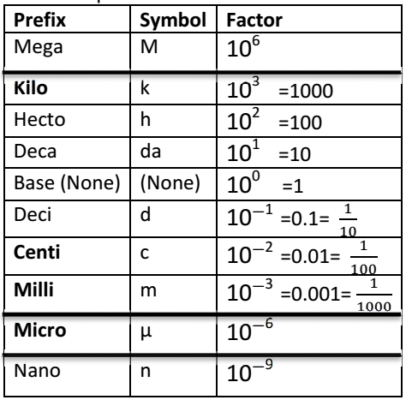
Prefixes: placed before the base unit to indicate a larger or smaller quantity; based on powers of 10.

Slide 7
x1000
x10
x10
x10
x10
x10
x10
x1000
x1000
Prefixes at the top of the chart represent a larger amount or quantity.
Prefixes at the bottom of the chart represent a smaller amount or quantity.

Slide 8
Using the “conversion factor” method to convert between metric units

Slide 9
Ex: Convert 1609 meters into kilometers

Slide 10
Ex: Convert 1609 meters into kilometers

Slide 11
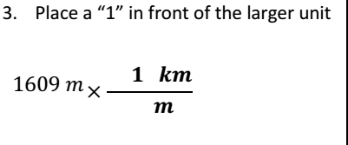
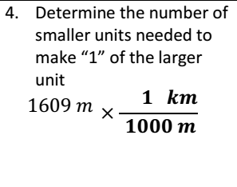
Ex: Convert 1609 meters into kilometers

Slide 12
Ex: Convert 1609 meters into kilometers

Slide 14
Measurement: When using tools with graduated “tick marks”, you should estimate one decimal place beyond the value of the smallest tick mark!
0.7 cm
Each tick mark represents 1 cm
→ round to nearest 0.1 cm

Slide 15
Each tick mark represents 0.1 cm
→ round to nearest 0.01 cm

Slide 16
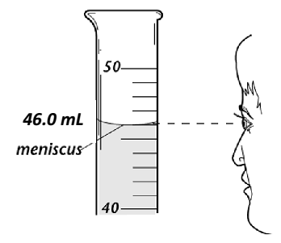
Reading Graduated Cylinders:
Liquids form a curved surface when in graduated cylinders. As a standard, you should read the liquid level from the bottom of the meniscus

Slide 18
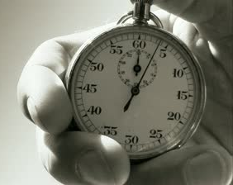
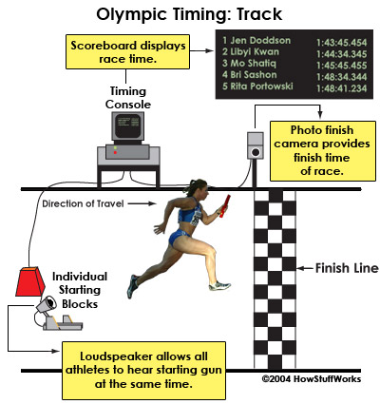
The Concept of Error
100 m dash 1912 record: 10.6 seconds
Usain Bolt 100 m dash: 9.58 seconds

Slide 19
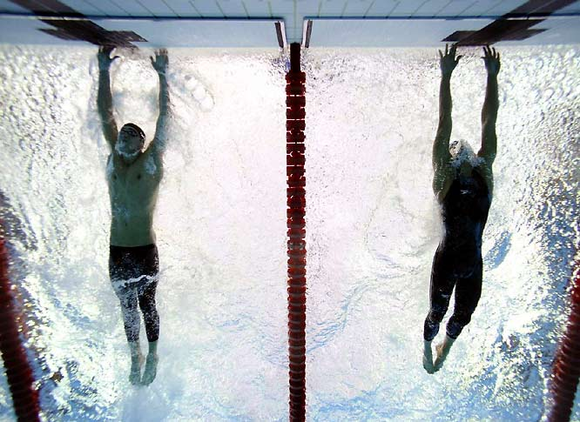
The Concept of Error
Michael Phelps 100 m butterfly:
50.58 seconds—beats 2nd place Milorad Cavic by 0.01 seconds!

Slide 20
The Concept of Error
3
4
Different people may report a different measurement when estimating the last digit

Slide 21
The Concept of Error
With each measurement, there is a degree of uncertainty/estimation beyond the markings
The last digit in a measurement is called the uncertain digit
Significant figures include all measured digits + the uncertain digit
The more significant figures, the more precise the measurement

Slide 22
Significant Figures
All non-zero numbers are ALWAYS significant
15=2 sig figs
145=3 sig figs

Slide 23
Significant Figures
Zeros between nonzero digits (squished zeros) are ALWAYS significant
105=3 sig figs
5005=4 sig figs
ALL zeros to the left of the first nonzero are NOT significant
0.0005=1 sig fig
0.0505=3 sig figs

Slide 24
Sig Fig Clarifications
If there is a decimal point, the 0’s at the end of the number DO count
9010.0 = 5 sig figs
If there is no decimal point, the 0’s at the end of the number DO NOT count!
91010 = 4 sig figs
For scientific notation, only count the sig figs for the decimal part (not the x 10^{x} part)

Slide 25
Pacific-Atlantic Method for Counting Significant Figures
If the decimal point is present, start counting digits from the Pacific (left) side, starting with the first non-zero digit
If the decimal point is absent, start counting digits from the Atlantic (right) side, starting with the first nonzero digit

Slide 26
How Many Sig Figs?
4
1234 ________
0.023 ________
890 ________
91010 ________
9010.0 ________
1090.0010 ________
0.00120 ________
3.4 x 10⁴ ________
9.0 x 10³ ________
9.010 x 10⁻² ________
2
2
4
5
8
3
2
2
4

Slide 27
Calculating with Significant Figures
Adding and Subtracting:
Count the number of decimal places for each measurement.
Round the final answer to the lowest number of decimal places.

Slide 28
Original Problem | Raw Answer | Final Answer w/ Proper Sig Figs and Units
3.482 cm + 8.51 cm + 16.324 cm
48.0032 g + 9.17 g + 65.4321 g
80.4 cm - 16.532 cm
106.5mL - 30. mL
28.316 cm
28.32 cm
Notes:
28.32 cm, 122.61 cm, 63.9 cm, 77 mL

Slide 29
Calculating with Significant Figures
Multiplying and Dividing:
Count the number of significant figures for each measurement
Round the final answer to the lowest number of significant figures

Slide 30
Original Problem | Raw Answer | Final Answer w/ Proper Sig Figs and Units
48.2 cm × 1.6 cm × 2.12 cm
8.3 m × 4.0 m × 0.9823 m
64.34 cm³ ÷ 8.149 cm
4.93 mm² ÷ 18.71 mm
32.61236 m³
33 m³
Notes:
160 cm3, 33 m3, 7.895 cm2, 0.263 mm

Slide 31
Sig Figs Exit Activity
2 stations.
You can write down all the digits the balances/scales give you.
You should round the volume measurements based on the tick marks on the graduated cylinder.
Turn in

