Slide 1
Do Now
Turn in Cricket Lab if you did not do so last Friday
Quiz #2: Sci. Method & Characteristics of Life Wed 9/14
Characteristics of Life Project due WED 9/14 (You will have class time to work on it today)

Slide 2
Humans
Does a human grow and develop?
Do humans eat other organisms or require energy?
Can humans reproduce?
Do humans respond to a stimulus?
Do humans require oxygen or gas exchange?
Based on your answers to questions 1-5, do you think human beings are considered to be alive?

Slide 3
Fire
Does fire grow and develop?
Does fire consume (or “eat”) other organisms or require energy?
Based on your observations, does fire reproduce?
Does fire respond to a stimulus?
Does fire require oxygen or gas exchange? What happens if you put a jar over the candle?
Based on your answers to questions 1-5, do you think fire is considered to be alive?

Slide 4
Biology is the study of living things. The following are 7 characteristics of living things: (O & C go together in the acronym)
“ROACH ERG!”

Slide 5
Characteristics of Living Things
Reproduction
Organization
Adaptation through Evolution
Cells
Homeostasis
Energy use and metabolism
Response to environment or stimuli
Growth and Development

Slide 6
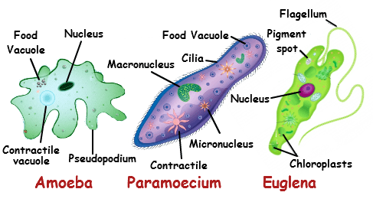
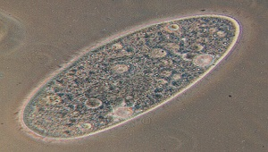
Cells
The basic structural and functional unit of all known living organisms.
Ex 1: the smallest living organisms are made up of only 1 cell (unicellular!)

Slide 7
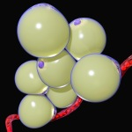
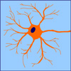
Cells continued.
Ex 2: the average human has 37.2 trillion cells in his/her body!
Nerve cell
Red blood cell
Fat cell

Slide 8
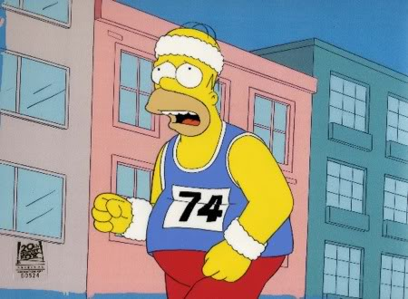
Homeostasis
A process of regulating and maintaining stable internal conditions
Ex: When exercising,
need more oxygen → breathe more heavily.
movement causes you to warm up → sweat to help you cool down

Slide 9
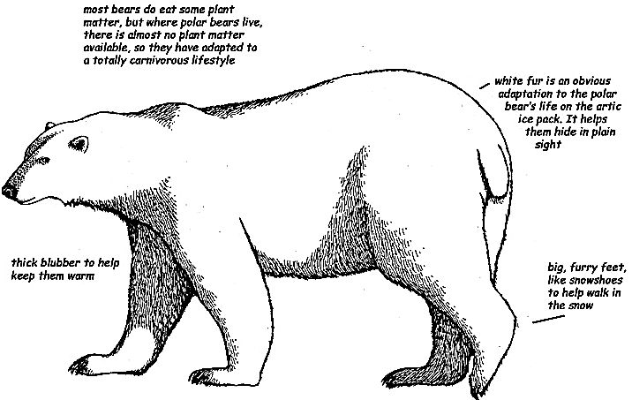
Adaptation and Evolution
Living things can adapt a trait that is better suited for their environment through evolution over a long period of time.
Ex:

Slide 10
Living Things also have some common needs…
Water
Source of energy (from sun, food, etc.)
Air: oxygen and carbon dioxide
A suitable habitat

Slide 11
Characteristics of Living Things Project
Complete on google slides and share with me: kye@k12albemarle.org
Choose a character from your favorite tv show/movie/comic/book/etc…
You must include a picture and a written example of how this character displays the 7 characteristics of living things.
You’ll need to get creative/inventive with what traits your character might have adapted or how he/she evolved over time.

Slide 12
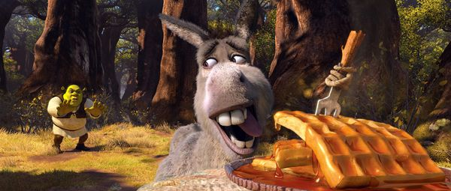
Example
The donkey from Shrek needs energy. Here, he gets his energy from waffles.

Slide 13
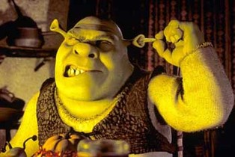
Example 2: Adaptation (get creative here)
Ogres that could provide light were more likely to survive, so ogres that had small, narrow ears that could make earwax candles were more likely to survive and pass on this trait.

Slide 14
Is it living?

Slide 15
Is it living?

