Slide 1
Do Now
Work on Unit Conversions Warm-Up
Today: Measurement, Significant Figures
Unit 1 Test TH 9/15 (B), FRI 9/16 (A)

Slide 2
Unit Conversions Do Now
8348 km
$21.98
90.48 weeks
0.746 kg
$56.25

Slide 3
Measurement: When using tools with graduated “tick marks”, you should estimate one decimal place beyond the value of the smallest tick mark!
0.7 cm
Each tick mark represents 1 cm
→ round to nearest 0.1 cm

Slide 4
Each tick mark represents 0.1 cm
→ round to nearest 0.01 cm

Slide 5
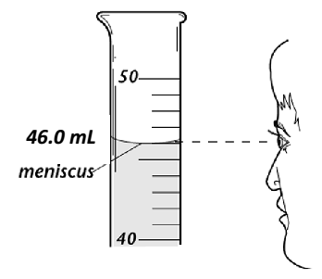
Reading Graduated Cylinders:
Liquids form a curved surface when in graduated cylinders. As a standard, you should read the liquid level from the bottom of the meniscus

Slide 7
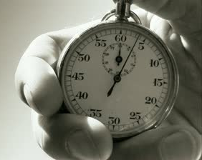
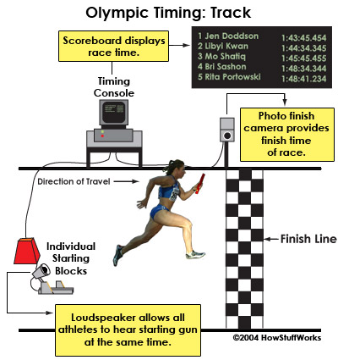
The Concept of Error
100 m dash 1912 record: 10.6 seconds
Usain Bolt 100 m dash: 9.58 seconds

Slide 8
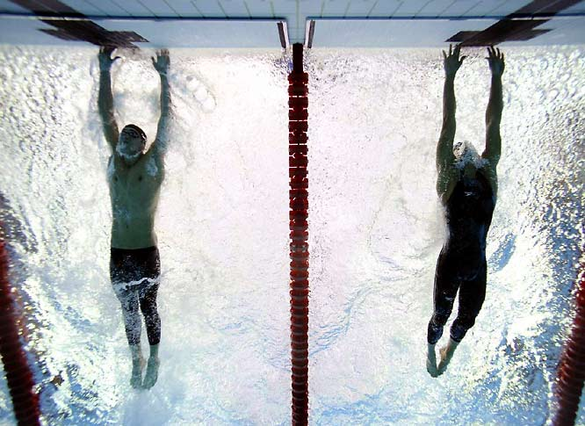
The Concept of Error
Michael Phelps 100 m butterfly:
50.58 seconds—beats 2nd place Milorad Cavic by 0.01 seconds!

Slide 9
The Concept of Error
3
4
Different people may report a different measurement when estimating the last digit

Slide 10
The Concept of Error
With each measurement, there is a degree of uncertainty/estimation beyond the markings
The last digit in a measurement is called the uncertain digit
Significant figures include all measured digits + the uncertain digit
The more significant figures, the more precise the measurement

Slide 11
Significant Figures
All non-zero numbers are ALWAYS significant
15=2 sig figs
145=3 sig figs

Slide 12
Significant Figures
Zeros between nonzero digits (squished zeros) are ALWAYS significant
105=3 sig figs
5005=4 sig figs
ALL zeros to the left of the first nonzero are NOT significant
0.0005=1 sig fig
0.0505=3 sig figs

Slide 13
Sig Fig Clarifications
If there is a decimal point, the 0’s at the end of the number DO count
9010.0 = 5 sig figs
If there is no decimal point, the 0’s at the end of the number DO NOT count!
91010 = 4 sig figs
For scientific notation, only count the sig figs for the decimal part (not the x 10^{x} part)

Slide 14
Pacific-Atlantic Method for Counting Significant Figures
If the decimal point is present, start counting digits from the Pacific (left) side, starting with the first non-zero digit
If the decimal point is absent, start counting digits from the Atlantic (right) side, starting with the first nonzero digit

Slide 15
How Many Sig Figs?
4
1234 ________
0.023 ________
890 ________
91010 ________
9010.0 ________
1090.0010 ________
0.00120 ________
3.4 x 10⁴ ________
9.0 x 10³ ________
9.010 x 10⁻² ________
2
2
4
5
8
3
2
2
4

Slide 16
Calculating with Significant Figures
Adding and Subtracting:
Count the number of decimal places for each measurement.
Round the final answer to the lowest number of decimal places.

Slide 17
Original Problem | Raw Answer | Final Answer w/ Proper Sig Figs and Units
3.482 cm + 8.51 cm + 16.324 cm
48.0032 g + 9.17 g + 65.4321 g
80.4 cm - 16.532 cm
106.5mL - 30. mL
28.316 cm
28.32 cm
Notes:
28.32 cm, 122.61 cm, 63.9 cm, 77 mL

Slide 18
Calculating with Significant Figures
Multiplying and Dividing:
Count the number of significant figures for each measurement
Round the final answer to the lowest number of significant figures

Slide 19
Original Problem | Raw Answer | Final Answer w/ Proper Sig Figs and Units
48.2 cm × 1.6 cm × 2.12 cm
8.3 m × 4.0 m × 0.9823 m
64.34 cm³ ÷ 8.149 cm
4.93 mm² ÷ 18.71 mm
32.61236 m³
33 m³
Notes:
160 cm3, 33 m3, 7.895 cm2, 0.263 mm

Slide 20
Sig Figs Exit Activity
3 stations
Tear off, turn in

