Slide 1
Agenda
Turn in Safety Contract if you did not do
Reminder: Quiz FRI 9/1 (Safety, Observations, Inferences)

Slide 2
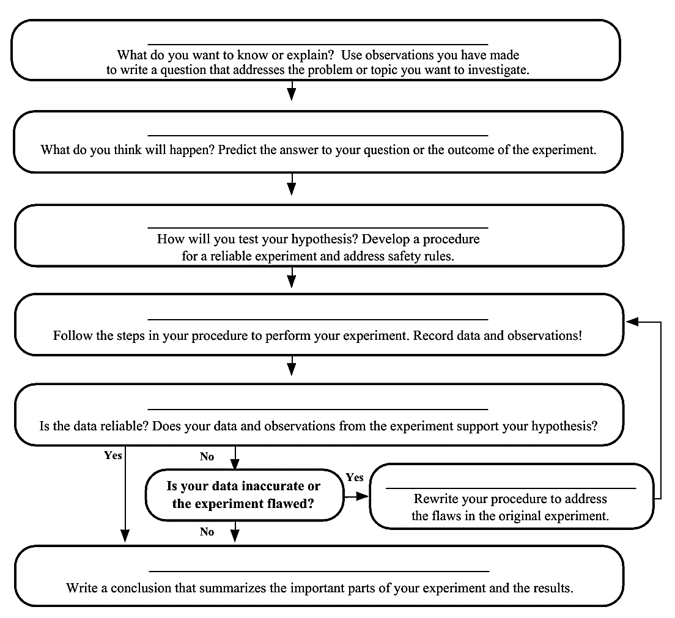
Identify the problem
Form a Hypothesis
Create an Experiment
Perform an Experiment
Analyze the Data
Modify the Experiment
Communicate the Results

Slide 3
Video Notes

Slide 4
Additional Information (not in video)
Constants=variables that are kept the same throughout the experiment

Slide 5
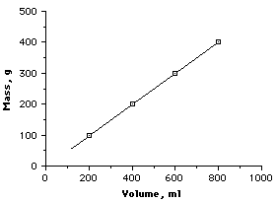
Patterns in Data: When appropriate, data can be plotted as a scatterplot and a trend (pattern or relationship) may be observed between the two variables
Direct Relationship=as one variable increases, the other variable also increases

Slide 6
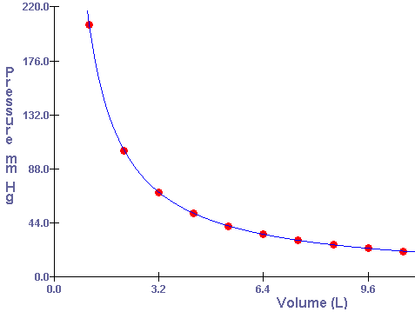
Inverse Relationship= as one variable increases, the other variable decreases

Slide 7
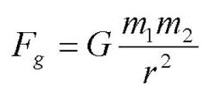
Law vs. Theory
A laW tells us what is happening/what the relationship between two variables is; often has a formula
Ex: Law of Gravity, Boyles’ Law
A theorY tells us whY something happens
Ex: Atomic Theory, Cell Theory
A theory cannot become a law!

Slide 8
Practice
Answer the questions for the 4 scenarios on your handout

Slide 9
Reaction Timer Activity

