Slide 1
AP Chem
Turn in Al Foil Lab and/or Safety Contracts if you did not do so last class.
Today:
Matter and Separation Techniques Review
Prepare for Chromatography Lab Tomorrow
Unit 1 Review Packet due Wed 9/12
Unit 1 Test ~Th 9/13 and Fri 9/14

Slide 2
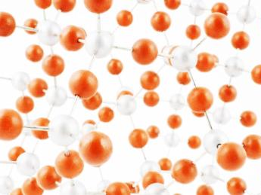
Chemistry is the study of the properties and interactions of matter
Matter=anything that has mass and takes up space
Atom=the smallest, simplest unit of matter
Atoms can combine or join together to form other substances:

Slide 3
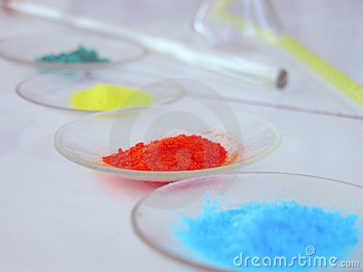
Classification of Matter

Slide 4
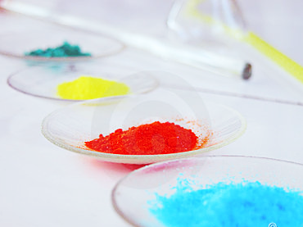
Pure Substances
Pure Substance=a substance that CANNOT be physically broken down. It can be separated by a chemical process ONLY
Element=a substance that is made up of only one type of atom
Elements CANNOT be broken down (decomposed) into simpler substances
All the elements that we know of are organized in the periodic table of elements

Slide 5
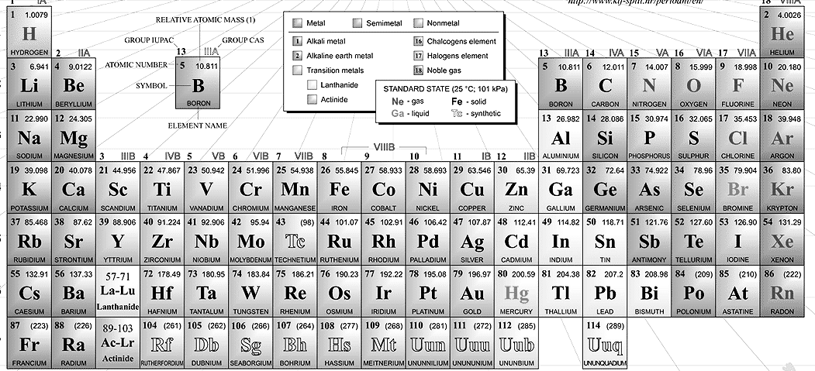
Diatomic Elements
2 atoms of the same type bonded together
H₂, N₂, O₂, F₂, Cl₂, Br₂, I₂…or “7 UP”

Slide 6
Pure Substances Cont.
Compound= a substance that is made up of 2 or more types of atoms.
Therefore, a compound is made up of 2 or more elements in a specific ratio or proportion.
Compounds can be chemically separated (decomposed) into the elements that make it up.

Slide 7
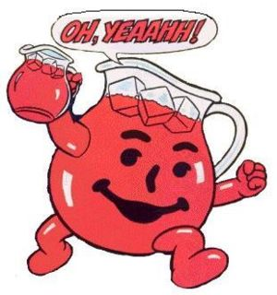
Pure Substances vs. Mixtures
Pure Substances=substances that cannot be physically separated into simpler substances
Mixture=a combination of 2 or more substances that can be physically separated into their individual parts without changing what they are
Mixtures can be made up of elements, compounds, or both.

Slide 8
Mixtures: “Salad”
homogeneous mixture=a mixture in which the particles are uniformly (evenly) spread
the individual substances making up the mixture cannot be easily seen
Most common type: solution
Ex: sugar dissolved in water; atmospheric air

Slide 9
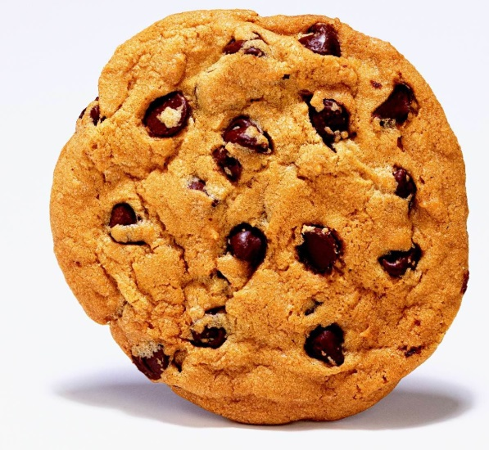
Mixtures
2. heterogeneous mixture=a mixture in which the particles are not uniformly spread
the individual substances making up the mixture can be easily seen
Ex: chocolate chip cookie, sand in water, salad

Slide 10
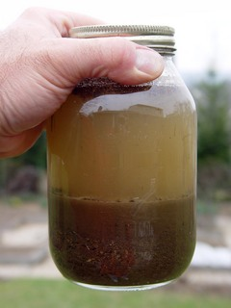
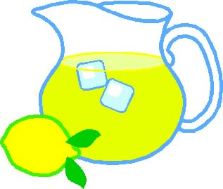
What do I mean by “uniformly spread”???
Consider a container of lemonade vs. a container of sand and water
Heterogeneous mixture: particles are NOT uniformly spread—you won’t get exactly the same stuff depending on where you take the sample from
Homogeneous Mixture: particles are uniformly spread--You get the same stuff no matter where you take the sample from

Slide 11
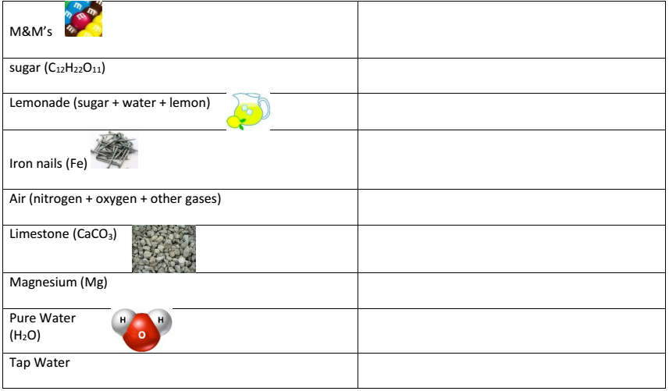
mixture
Pure substance—compound
mixture
Pure substance—element
mixture
Pure substance—compound
Pure substance—element
Pure substance—compound
mixture

Slide 12
v
Pure substance —compound
Pure substance —element
Pure substance: diatomic element
mixture

Slide 13
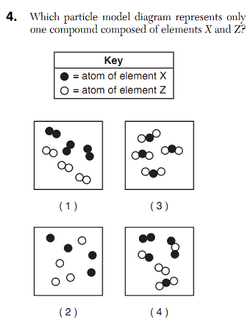

Slide 14
Properties of Matter-Definitions
Physical Property=a property of matter that can be measured or observed without changing the chemical composition of the substance
Ex: mass,
melting and boiling point,
Solubility (ability to dissolve in something)

Slide 15
Properties of Matter-Definitions
Chemical Property=a property of matter that can only be measured or observed by changing the chemical composition of the substance
Ex:
Flammability
Reactivity (whether the substance reacts with another substance)

Slide 16
Intensive vs. Extensive Properties
Intensive Property: does NOT depend on how much of the substance there is
Ex: Boiling Point
Extensive Property: depends on how much of the substance there is
Ex: Mass

Slide 17
C
C
C
E
C

Slide 18
Recall…
Mixture=a combination of 2 or more substances that you can physically separate into their individual parts without changing what they are.
Mixtures can be separated based on their physical properties (ex: boiling point, solubility, size)

Slide 19
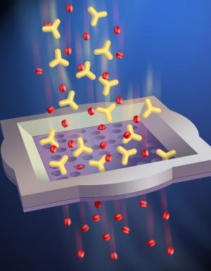
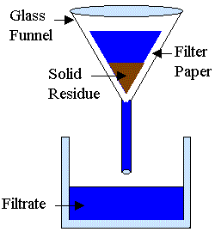
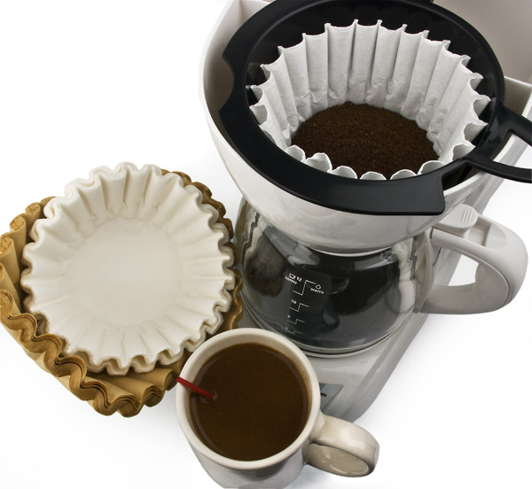
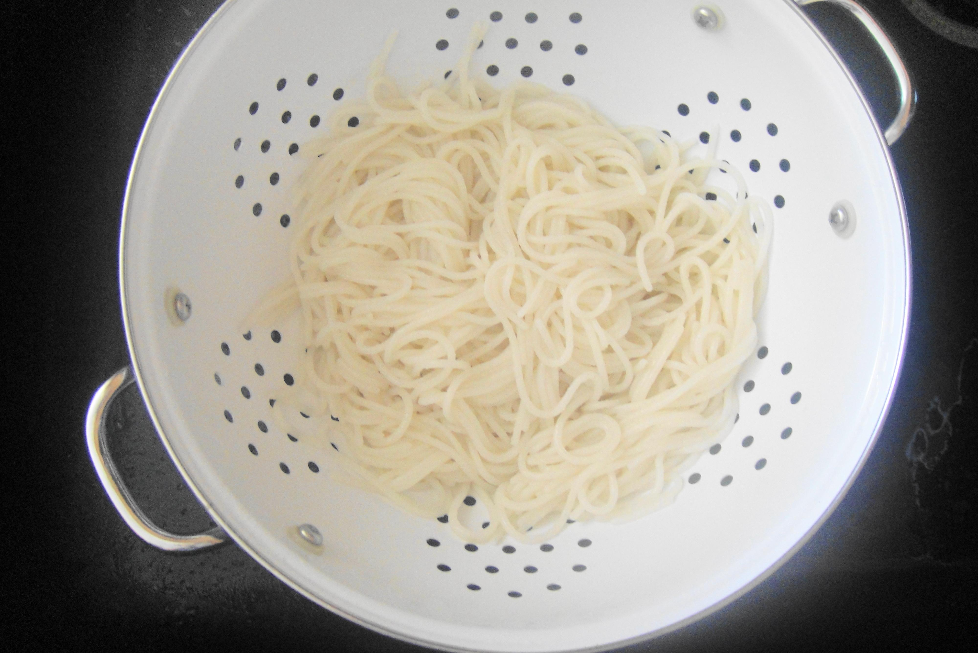
Filtration
*separation based on different state of matter or particle size
a technique that allows you to separate a heterogeneous mixture by catching the solid (undissolved particles) on the filter

Slide 20
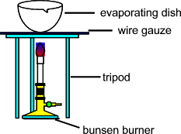
Evaporation
takes advantage of differences in boiling point
can be used to separate homo- or heterogeneous mixtures
Downside: liquid components of mixture are lost to air through evaporation

Slide 21
Distillation
takes advantage of differences in boiling point
can be used to separate homogeneous or heterogeneous mixtures
Superior method to evaporation because all components can be isolated and retained.
The liquid with the lower boiling point collects in this flask
Mixture of 2 liquids is placed in a flask over a heat source. The liquid with the higher boiling point stays in this flask

Slide 22
Chromatography
Chromatography is a technique that allows you to separate a homogeneous mixture based on size and polarity
*polarity = the symmetry of a molecule; determines the level of attraction towards other substances
Separate
Mixture
Components

Slide 23
How Chromatography Works
Chromatography paper
Developing
chamber
Place into
Small samples of substances
liquid solvent
Capillary action draws the dye samples up the paper as the solvent moves up the paper

Slide 25
Separation by Chromatography
How the components separate depend on how attracted the individual components are to the chromatography paper versus the solvent
If the components are more attracted to the solvent, it will move further up the paper with the solvent.
“Like dissolves like”
In your lab you will calculate Rf values, which is a ratio of how far the dye moved compared to the solvent.
B is more attracted to the solvent; B and the solvent have similar polarities.

Slide 26
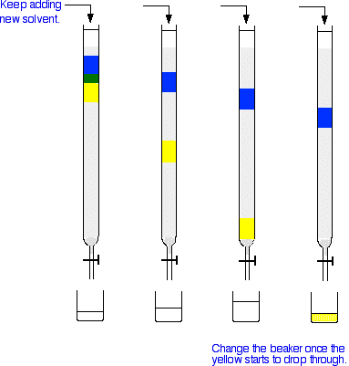
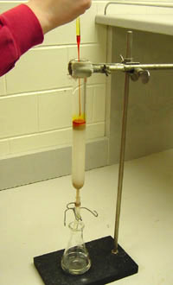
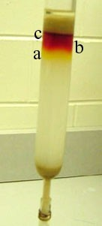
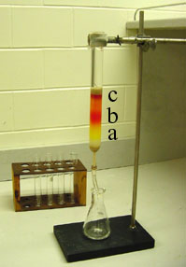
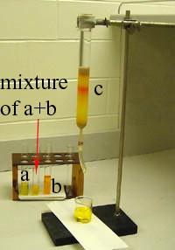
Column Chromatography
Separates the components of a mixture based on the differences in size
The smallest molecules exit the column first
The largest molecules exit the column last
Separation can also be based on polarity (attraction) to the material in the column

Slide 27
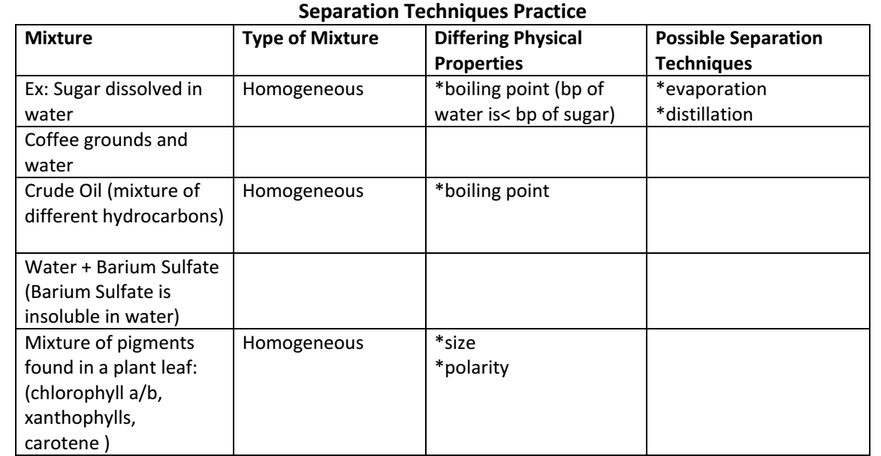
Which separation technique should you use?

Slide 28
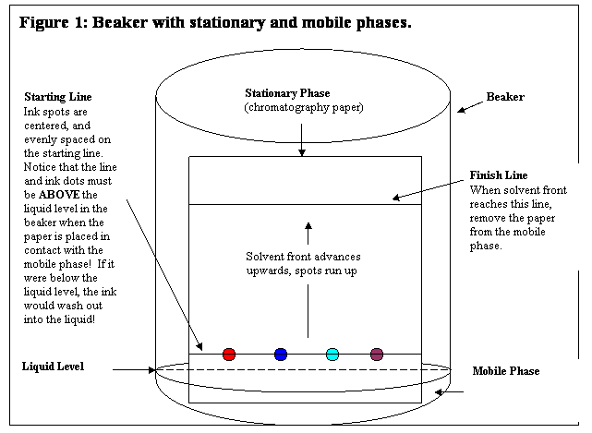
Chromatography Pre-Lab/Concept Review
1 2 3 4

