Slide 1
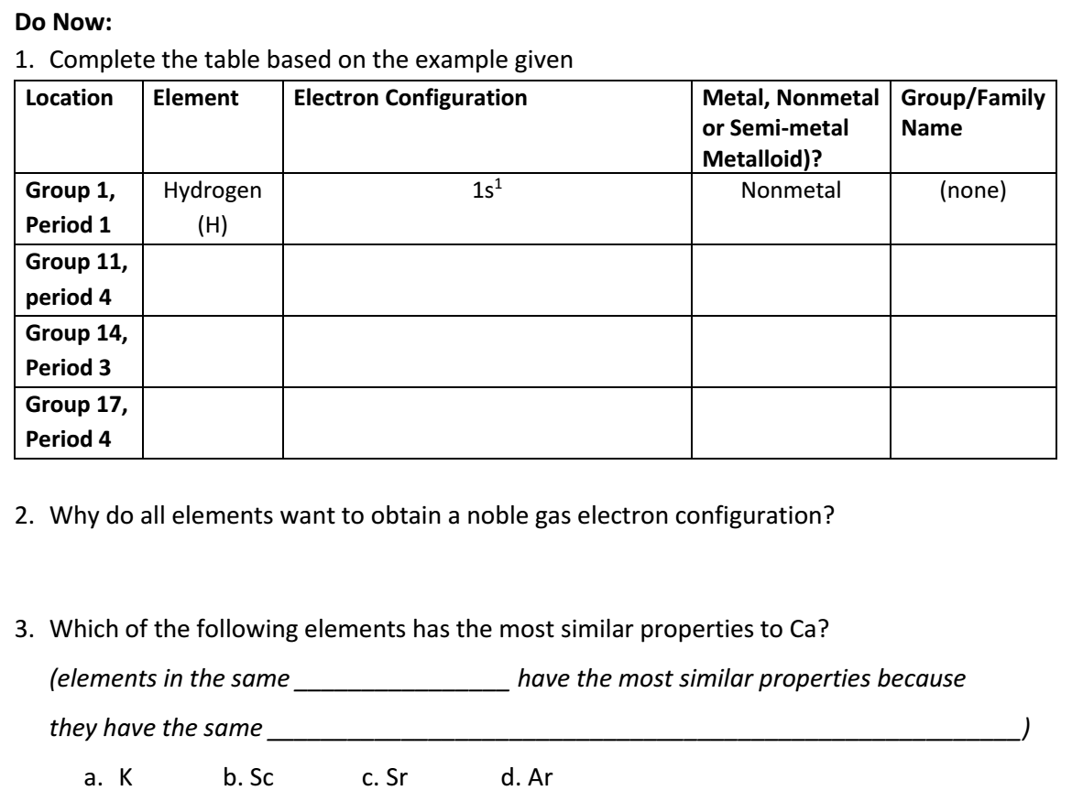
AP Chem
Turn in Flame Test Lab.
Take out Electron Configurations/Orbital Diagrams packet to be checked
Work on Do Now questions & Pre-Lab
Today:
Reactivity of Metals Lab-formal lab write-up due next Tue 10/3
Periodic Trends Review

Slide 2
Reactivity Lab
Answer pre-lab question
Collect data
Obtain solutions in test tubes—fill less than ½ way full!
Be careful with silver nitrate—it can stain your skin and clothing!
Dispose of waste in designated beakers; rinse out test tubes
Formal Lab Write Up due next Tue 10/3

Slide 3
Periodic Trends Recap
We are going to go over today how radius, electronegativity, and ionization energy changes as you go down a group and across a period.

Slide 4
Effective Nuclear Charge-a measure of the positive attractive force of the nucleus towards negatively charged electrons due to the number of protons in the nucleus; how much attractive force an electron feels can be affected by the number of shielding electrons (defined below)
Electron Shielding Effect-electrons in the energy levels closest to the nucleus protects the electrons in the outermost shell and lessens the effect of the positive, attractive force of the nucleus. Added shells decrease the effective nuclear charge.

Slide 5
Atomic Radius: size of atom
When looking at elements going down a GROUP,
atomic radius INCREASES

Slide 6
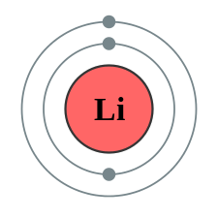
Atomic Radius
As you go down a group, more electron shells or energy levels are being added, thus increasing the size of the atom

Slide 7
Atomic Radius
When looking at elements going across a PERIOD,
atomic radius DECREASES

Slide 8
Atomic Radius: Periods
As you go across a period, the effective nuclear charge increases, therefore the nucleus more strongly attracts (pulls in) the electrons of the atom, and the radius decreases
Li
Be
Li
Be
+
+
+
+
+
+
+

Slide 9
Circle the element with the larger radius

Slide 10
Electronegativity: tendency to attract or gain an electron
When looking at elements going across a PERIOD,
electronegativity INCREASES

Slide 11
Electronegativity
As you go across a period, the effective nuclear charge increases, therefore the nucleus can attract (gain) another electron more easily,
Elements towards the right side of the periodic table are “closer to becoming a noble gas—they want to gain electrons”
Exception: Noble Gases have no electronegativity (they’re already happy—do not want to gain electrons)

Slide 12
Electronegativity
When looking at elements going down a GROUP,
electronegativity DECREASES
As you go down a group, the atomic radius increases. The inner shells shield the valence electrons from the nucleus, therefore decreasing the effective nuclear charge and the attraction for electrons

Slide 13
Circle the element with the larger electronegativity
Neither (they are noble gases)

Slide 14
Ionization Energy: energy needed to remove an electron
When looking at elements going down a GROUP,
ionization energy DECREASES

Slide 15
Ionization Energy
As you go down a group, the atomic radius increases. With more shells being added, the inner shells shield the valence electrons from the nucleus, therefore decreasing the effective nuclear charge and attractive force on the electrons, making them easier to remove.

Slide 16
Ionization Energy
When looking at elements going across a PERIOD,
ionization energy INCREASES

Slide 17
Ionization Energy
As you go across a period, the effective nuclear charge increases, therefore the nucleus more strongly attracts the electrons of the atom, making it harder to remove an electron
Elements towards the right side of the periodic table DO NOT want to lose electrons (they want to gain electrons) to become like a noble gas. Therefore, it is difficult (requires more energy) to remove an electron

Slide 18
Circle the element with the larger ionization energy

Slide 19
First, Second, Third Ionization Energy
1st Ionization Energy – energy required to remove 1 electron
2nd Ionization Energy –energy required to remove 2nd electron
3rd Ionization Energy –energy required to remove 3rd electron
In general 1st I.E. < 2nd I.E. < 3rd I.E. Because as the # of electrons decreases, the nucleus has a stronger pull on the electrons that are remaining.
Based on the relative “jump” between ionization energies, you can tell how many valence electrons the element has

Slide 20
Between 3rd and 4th I.E.
3 (“happy” with losing 3, doesn’t want to lose a 4th)
Group 13
Group 2

Slide 21
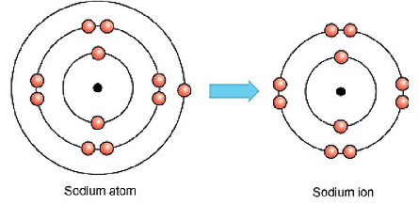
Ions and Ionic Radius
When an atom loses electrons and becomes a cation, its radius becomes smaller than that of the neutral atom
# protons greater than # electrons, therefore increasing the effective nuclear charge, meaning that there is a stronger pull of the electrons towards the nucleus.

Slide 22
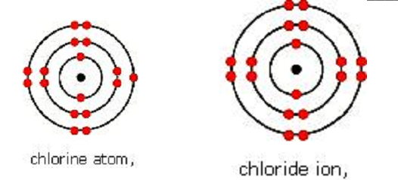
Ions and Ionic Radius
When an atom gains electrons and becomes an anion, its radius becomes larger than that of a neutral atom
When electrons get added to the same energy level, they repel each other

Slide 23
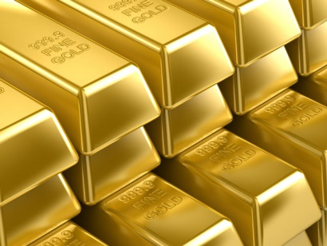
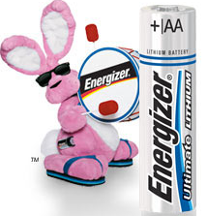
Metals
Generally solids at room temperature
malleable (can be hammered/molded into sheets)
ductile (can be drawn/pulled into a wire)
Have luster (are shiny when polished)
Good conductors (allow heat & electricity to flow throw them)

Slide 24
Nonmetals:
Solids, liquid, or gas at room temperature
NOT malleable or ductile; instead, they are brittle (shatter easily)
DO NOT have luster; instead, they are dull
They are either non or poor conductors

Slide 25
Reactivity of Metals vs. Nonmetals
Reactivity of a metal is related to its ionization energy
The lower its ionization energy, the more reactive the metal
Trend (within the metals on the periodic table):
Going down a group: reactivity increases
Going across a period: reactivity decreases
Most reactive metal: theoretically, Francium, but since it’s so unstable, realistically it’s Cesium

Slide 26
Reaction of Alkali Metals + Water

Slide 27
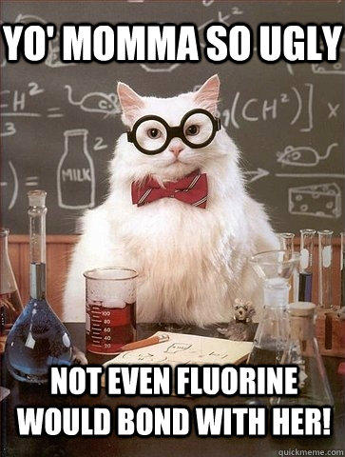
Reactivity of a nonmetal is related to its electronegativity
The higher the electronegativity, the more reactive the nonmetal
Trend (within nonmetals on the periodic table):
Going down a group: reactivity decreases
Going across a period: reactivity increases
Most reactive nonmetal: fluorine

Slide 28
PES
Positive charge from nucleus holds the electrons in the atom
When the net attractive force (# protons) is higher, the ionization energy (amount of energy required to remove the electron) also increases
Electron 1 will require more energy to remove. Electron 3 is easier to remove because it feels less of an attractive force since it’s being shielded by the inner shell.

Slide 29
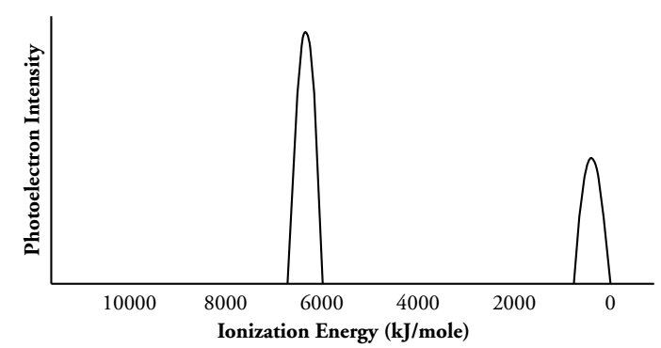
1s
2s
Units are kJ/mole. The values on the left of the graph are higher.
The peak on the left represents electrons that are more tightly held by the nucleus because the ionization energy for those electrons are higher.
The higher energy peak is about twice as high since there are 2 electrons in the 1s sublevel and 1 electron in the 2s sublevel for a neutral lithium atom.

Slide 30
Peak | A | B | C
Sublevel | 1s | 2s | 2p
# of electrons | 2 | 2 | 6

Slide 31
2p⁶
2p⁶
1s²
2s²
3p³
3p⁴
3s²
1s²
2s²
3s²
15a: P & S have the same # of occupied energy levels, but S has 1 more proton in its nucleus → Sulfur’s electrons feel a stronger pull from the nucleus than the electrons in Phosphorous, so the ionization energies are all slightly higher.
15b: P has 3 half-filled p-orbitals (3p ↑ ↑ ↑) whereas S has 1 p orbital that is completely full (3p ↑↓ ↑ ↑). It is desirable to lessen the repulsive forces between electrons, so removing a 3p electron from S will be easier than removing a 3p electron from P

Slide 32
To complete in note packet
Periodic Trends Questions & any remaining PES diagram questions.

