Slide 1
Welcome to Chemistry! Do Now:
Grab the handouts on the front desk
Find your seat
Using your laptop or phone, please fill out the short google form here: bit.ly/welchem
When done, introduce yourself to the person next to you

Slide 2
Introductions

Slide 3
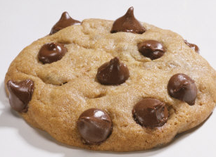
Cookie Activity
Groups of 2-3: Go to one of the lab benches with a whiteboard
Record as many observations as you can about your cookie (make a mental note about your cookie’s number)
DO NOT eat the cookie yet (I will let you afterwards)
When finished, log on to your computers and go to chemistrye.weebly.com

Slide 4
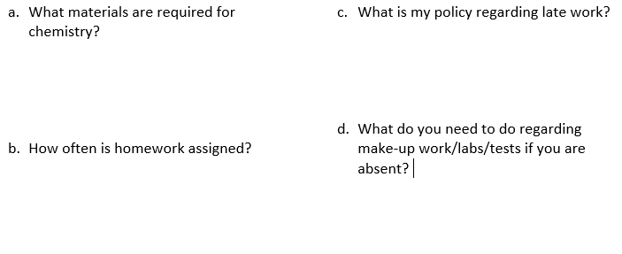
Syllabus and Safety Contract Overview
Log on to your computers and go to chemistrye.weebly.com
Answer the questions on the handout regarding class expectations and safety rules

Slide 5
Syllabus Overview

Slide 6
Syllabus Overview

Slide 7
Syllabus Overview

Slide 8
Safety Video
https://www.youtube.com/watch?v=xJG0ir9nDtc

Slide 9
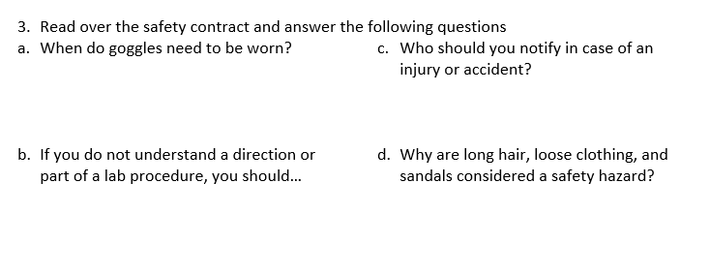

Slide 10
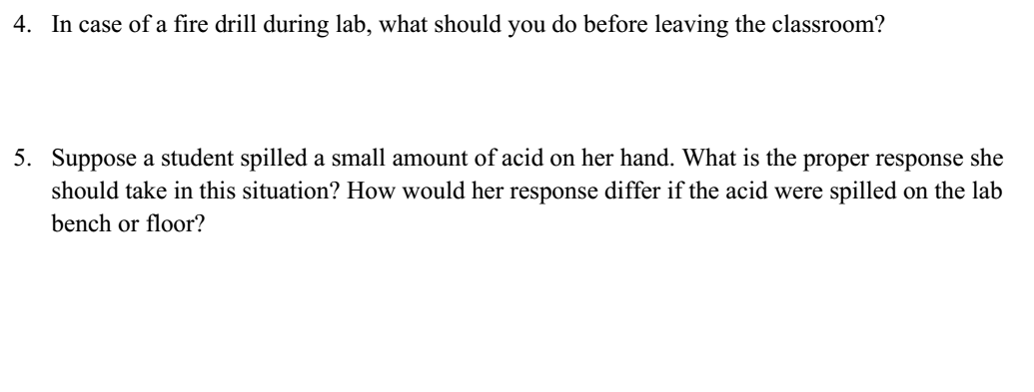
Fire Drills & Acid Spills…
Unplug electrical components (i.e. hot plate)
Turn off gas if using Bunsen Burner
If spilled on hand: Rinse under water for ~15 min
If spilled on lab bench or floor: Neutralize the acid with a base such as Sodium Bicarbonate (Baking Soda)

Slide 11
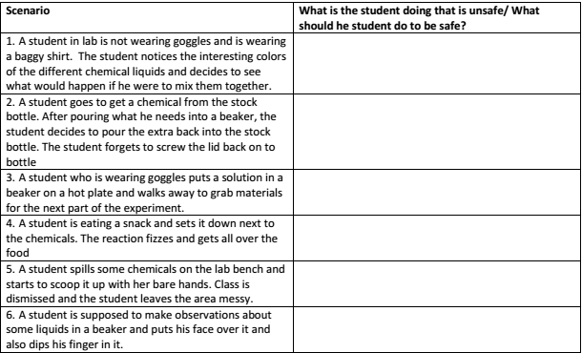
Safety
Not wearing goggles
Wearing baggy shirt
Not following lab instructions—mixes chemicals together
Pours extra chemical back into stock bottle; doesn’t screw lid back on bottle (contaminates stock)
Leaves experiment unattended—make sure someone else is at the lab table watching the experiment if you need to go get something!

Slide 12
Eating in lab area!
Picked up chemical with bare hands
Doesn’t clean up lab area
Puts face over beaker that contains a chemical
Places finger in chemical

Slide 13
Safety Contracts
Return (signed by you and a parent or your advisor) ASAP
Safety and Equipment Quiz this Friday!

Slide 14
Cookie Revisited
Go to a DIFFERENT lab bench than the one you were working at. You should be looking at a whiteboard that contains observations about another group’s cookie
Based on the observations, find that group’s cookie!

Slide 15
Cookie Revisited
You will be asked to make a lot of observations in this class!
Important to record detailed observations so someone else has an idea of what was going on!
Science is a collaborative effort—you will be asked to work together with your classmates to solve problems!

Slide 16
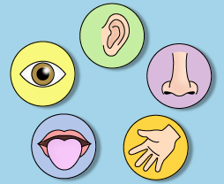
Chemistry, and science in general, involves making observations and inferences to help us better understand how things work
Observation=information collected by your 5 senses
Safety First!!! Which 3 of the five senses will you NOT use to make observations unless the teacher tells you it’s OK?
Taste, smell, touch
Qualitative Observation: cannot be measured or counted
Quantitative Observation: can be measured or counted

Slide 17
Inference=a conclusion you make based on your observations, prior knowledge

Slide 18
Observations vs. Inference
Observation | Inference
The cookie has 7 chocolate chips
My little brother must have taken a bite out of this cookie (even though I didn’t see him do it)
This is something anyone can observe
This is something you conclude based on how it looks, based on your previous experiences with cookies…

Slide 19
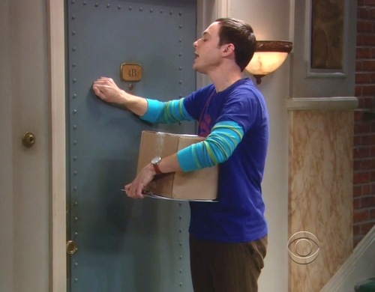
1. Make 1 Observation & 1 Inference about the following picture

Slide 20
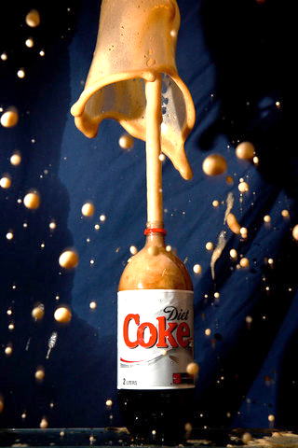
2. Make 1 Observation & 1 Inference about the following picture

Slide 21
Demo
Make 2-3 observations from the demo
Make 1-2 inferences about what you think happened or what the liquid is

Slide 22
Homework
Get Safety Contract Signed
Second page in packet: Look up names and function of lab equipment: quizlet.com/_1wz5tt
(Don’t worry about the “map of the classroom)
Lab Safety and Equipment Quiz Friday!

