Slide 1
Do Now
Get pH/pOH worksheet checked
Work on “Do Now” problems
Acids & Bases Quest Thurs 5/2

Slide 2
Neutralization=When an acid and base react with each other
Consider the Reaction between Acetic Acid and Sodium Hydroxide:
HC₂H₃O₂ + NaOH → _________ + ______
1. What is the neutral compound that is formed when an acid and base react?
H₂O
2. What is the second compound that is formed?
NaC₂H₃O₂
NaC₂H₃O₂
H₂O

Slide 3
Every Neutralization Reaction Involves:
acid + base → water + salt (ionic compound)
Neutralization reactions are double replacement reactions!

Slide 4
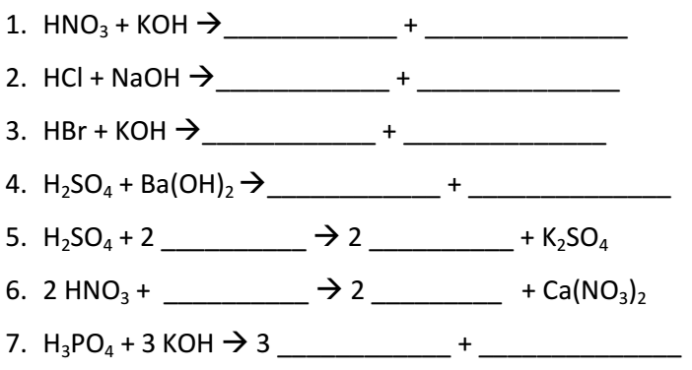
Practice

Slide 5
Titration
Titration-a method used to calculate the concentration (molarity) of an unknown acid or base
**Acid of known concentration is added to a base of unknown concentration, or vice versa.
When the moles of H⁺ = moles of OH⁻, the solution is neutral and the titration is complete.

Slide 7
Sample Problem 1: What is the concentration of a solution of HI if 0.3 L is neutralized by 0.6 L of 0.2 M solution of KOH?
M_{A}= V_{A}= M_{B}= V_{B}=
?
M_{A} x 0.3L = 0.2 M x 0.6 L
0.3 L
0.2 M
M_{A} = 0.4 M
0.6 L

Slide 8
Sample Problem 2: What is the concentration of a hydrochloric acid solution if 50.0 mL of a 0.250 M KOH solution are needed to neutralize 20.0 mL of the HCl solution of unknown concentration?
M_{A}= V_{A}= M_{B}= V_{B}=

Slide 9
Sample Problem 3: A particular acid has an H+ concentration of 0.1 M and a volume of 100 mL. What volume of a base with a 0.5 M OH- concentration will be required to neutralize the reaction?
M_{A}= V_{A}= M_{B}= V_{B}=

