Slide 1
Chem
Today: Stoichiometry Review/Practice
Limiting Reactant, Percent Yield
S’mores Lab-turn in
Finish “Mole Tunnel” Questions for HW
Stoichiometry Quiz Fri 4/28 (A), Tues 5/2 (B) (end of class)

Slide 2
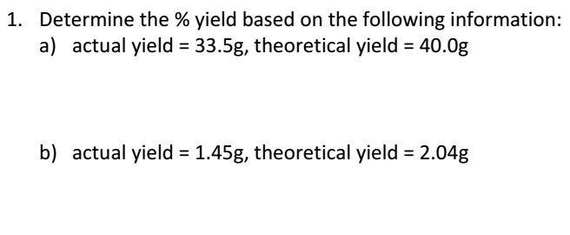
$$\frac{33.5 g}{40.0 g}×100$$

Slide 3
Add to note sheet:
Limiting Reactant-what you have LESS of. Determines how much product you can make.
Excess Reactant-what you have EXTRA of.

Slide 4
$$21. 6 g C3H6$$
$$×\frac{1 mol C3H6}{42.09 g C3H6}$$
$$×\frac{4 mol C3H3N}{4 mol C3H6}$$
$$×\frac{53.07 g C3H3N}{1 mol C3H3N}$$
=27.23 g C₃H₃N
$$21. 6 g NO$$
$$×\frac{1 mol NO}{30.01 g NO}$$
$$×\frac{4 mol C3H3N}{6 mol NO}$$
$$×\frac{53.07 g C3H3N}{1 mol C3H3N}$$
=25.5 g C₃H₃N
25.5 g C₃H₃N
LIMITING: NO EXCESS: C₃H₆
$$\frac{23.5 g}{25.5 g}×100$$

